Slide 1
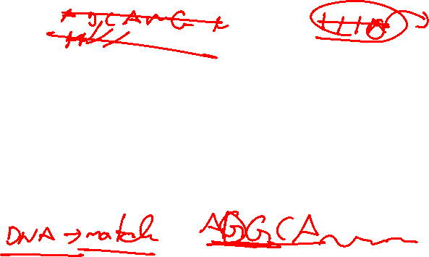
What is the Longest Common Subsequence?
The Longest Common Subsequence (LCS) problem is to find the longest subsequence common to two sequences.
A subsequence is a sequence derived by deleting some or none of the characters without changing the order of the remaining characters.
The LCS problem has applications in file comparison, bioinformatics, and DNA sequencing.

Slide 2
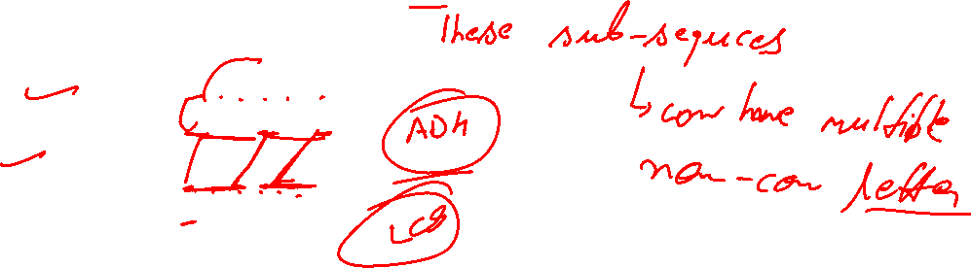
Example of LCS
Sequence 1: ABCDGH
Sequence 2: AEDFHR
LCS: ADH (The longest common subsequence is ADH)

Slide 3
Applications of LCS
1. Bioinformatics: DNA sequence alignment
2. File comparison: Identify similarities and differences between files
3. Data deduplication: Detect common data in different versions of files

Slide 4
Subsequences
A subsequence is a subcollection of the elements of a sequence, taken in the order they appear in the sequence.
For instance, if the sequence is ABCDEA, then ACDA is a subsequence (ABCDEA), but AEC is not.
One can also think of a subsequence as the original sequence
with some elements crossed out: AB\CDE\A
It is easiest to think of the sequences as strings, but in reality, any sequences can be used, such as sequences of integers or real numbers or customer records.
4 15 24 14 19 33 8 17 has a subsequence 24 19 8 17.

Slide 5
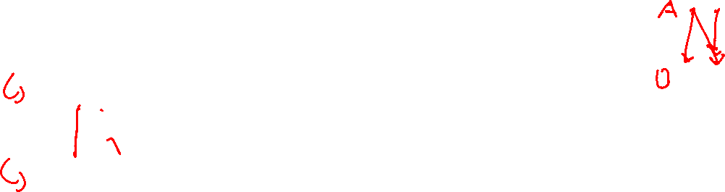
Longest Common Subsequence
The Longest Common Subsequence (LCS) problem is to find a longest sequence that is a subsequence of two given sequences.
For example, suppose we have two DNA strands encoded as
X=ACCGGTCGAGTGCGCGGAAGCCGGCCGAA
and
Y=GTCGTTCGGAATGCCGTTGCTCTGTAAA
The length of the LCS is then a measure of the similarity of the strands.

Slide 6
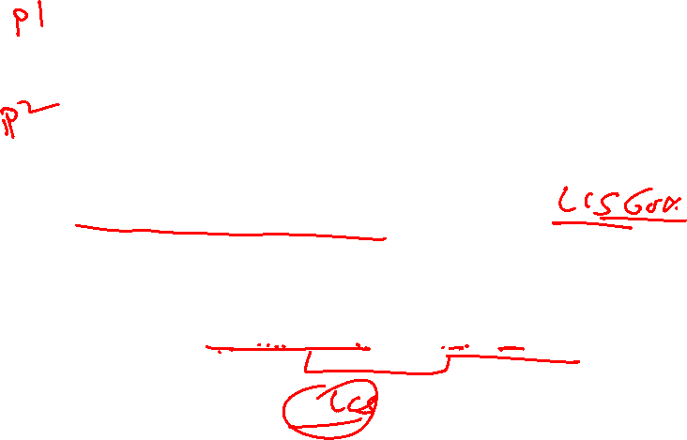
Longest Common Subsequence
For these strings, X=ACCGGTCGAGTGCGCGGAAGCCGGCCGAA
Y=GTCGTTCGGAATGCCGTTGCTCTGTAAA an LCS is GTCGTCGGAAGCCGGCCGAA.
For X = SPRINGTIME and Y = PIONEER, an LCS is PINE (SPRINGTIME and PIONEER).

Slide 7
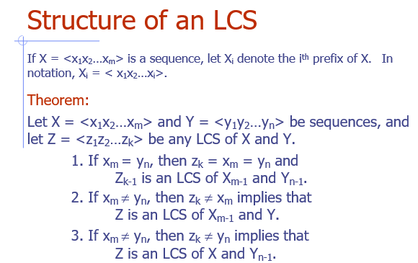

Slide 8
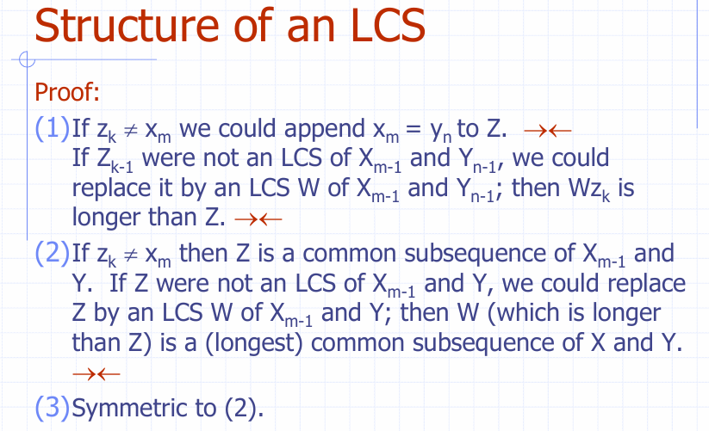

Slide 9
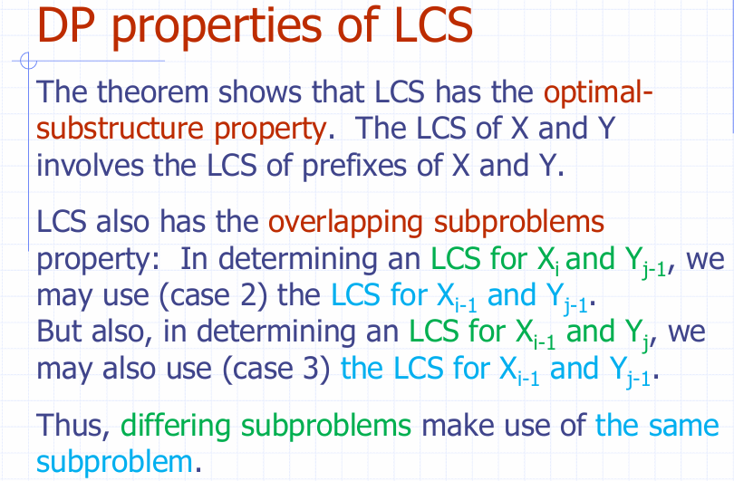

Slide 10
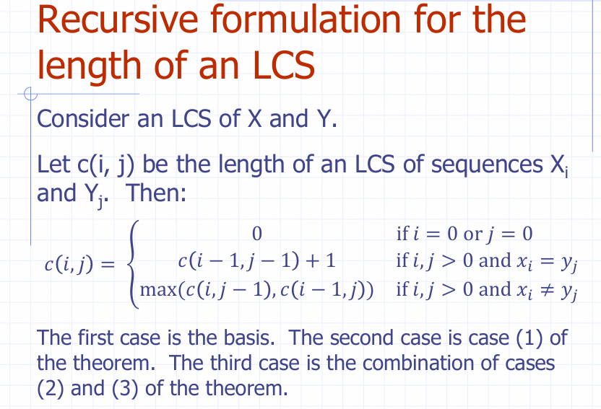

Slide 11
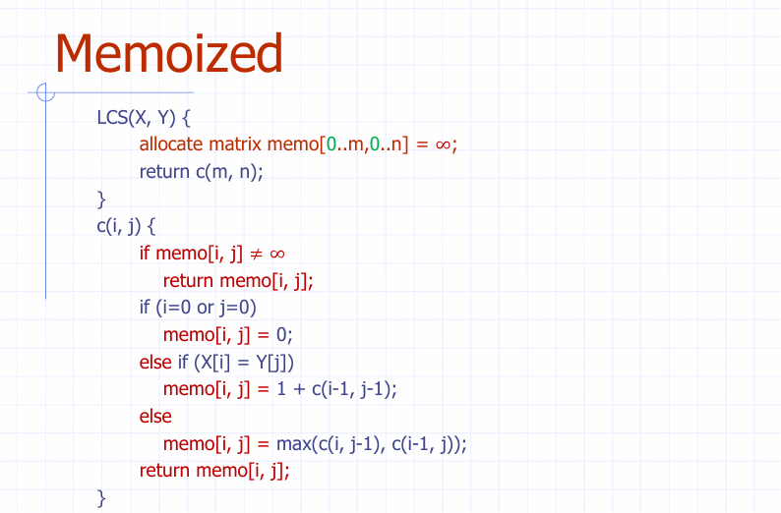

Slide 12
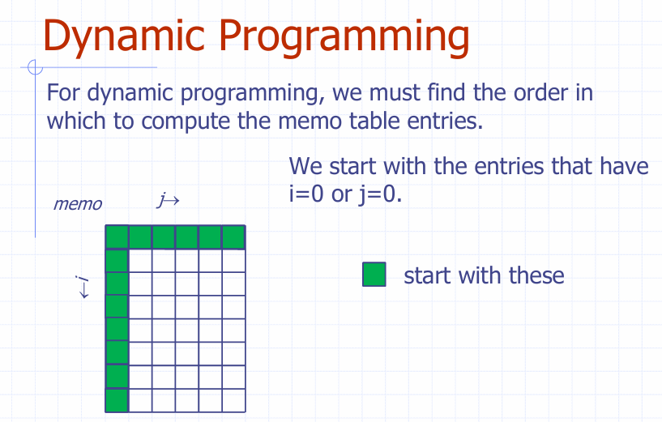


Slide 13
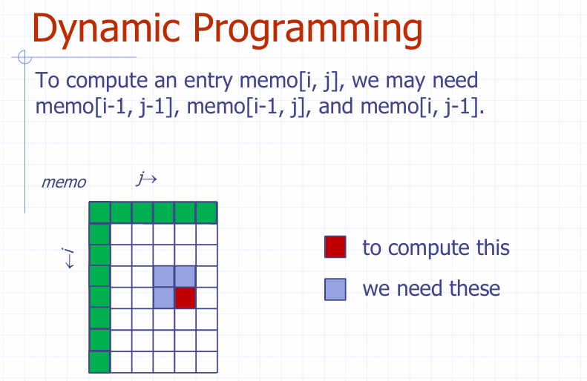


Slide 14
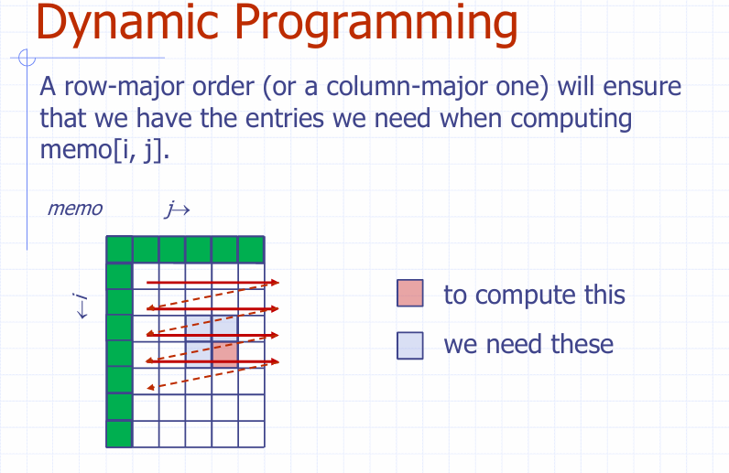

Slide 15
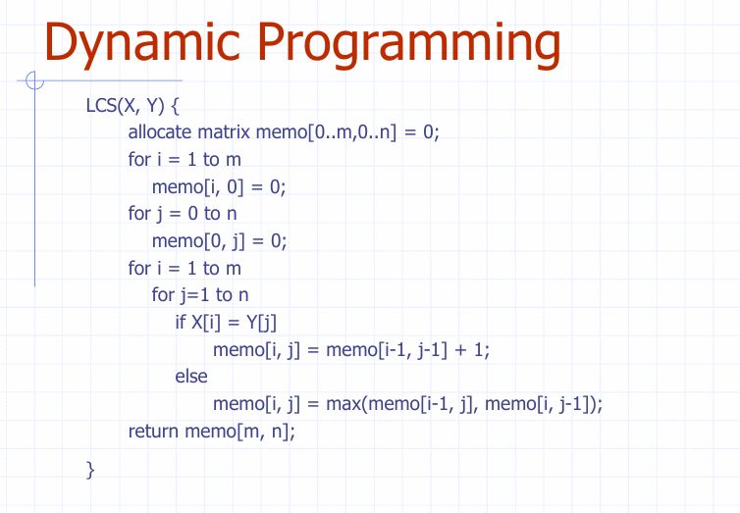

Slide 16
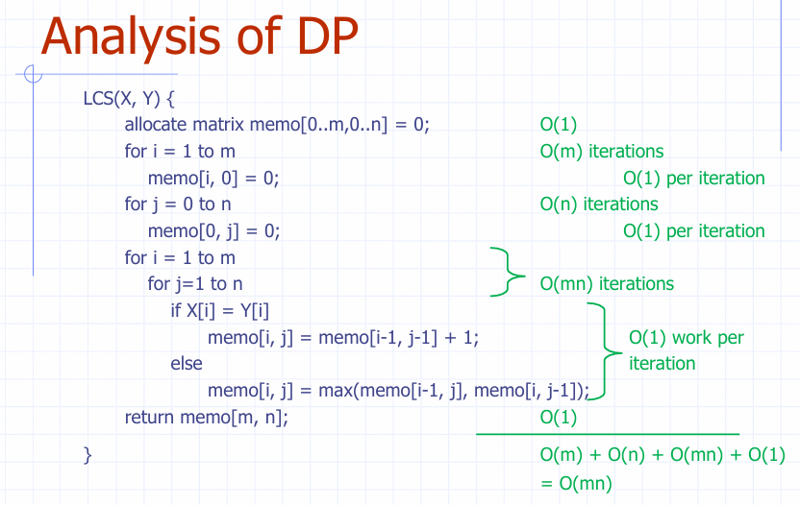

Slide 17
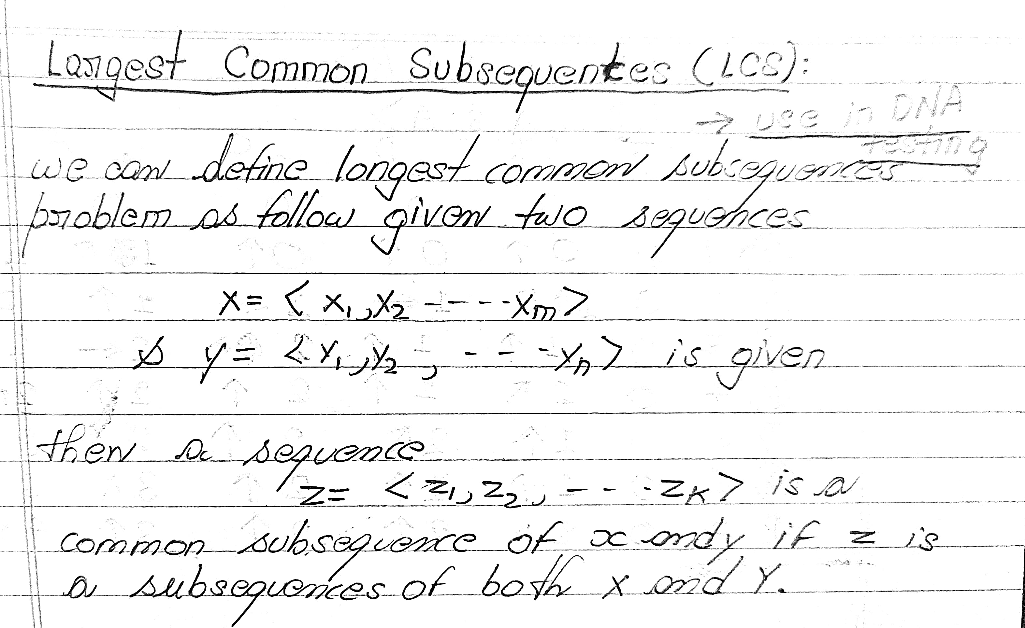

Slide 18
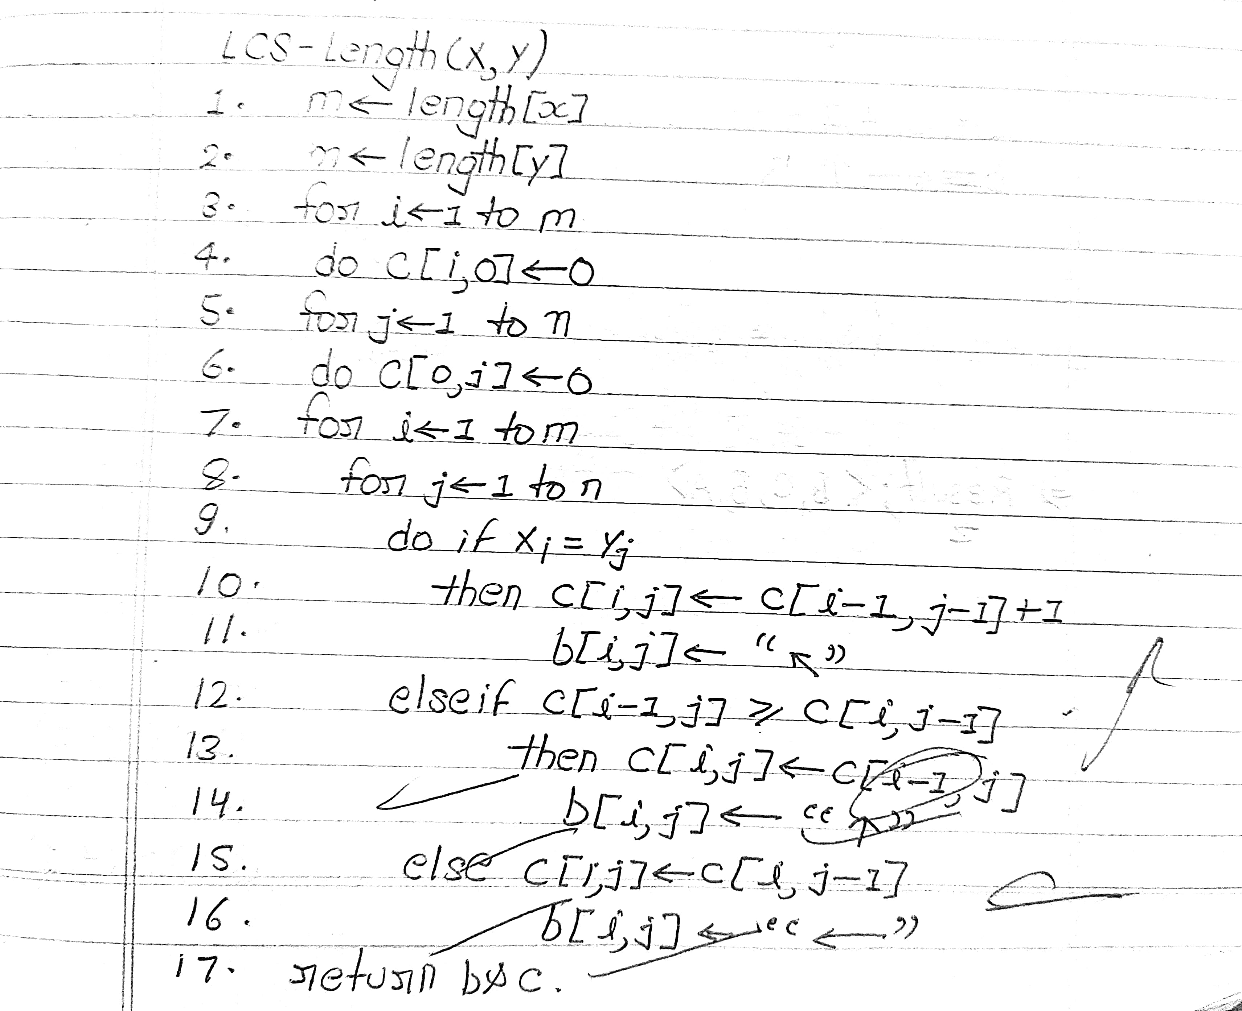
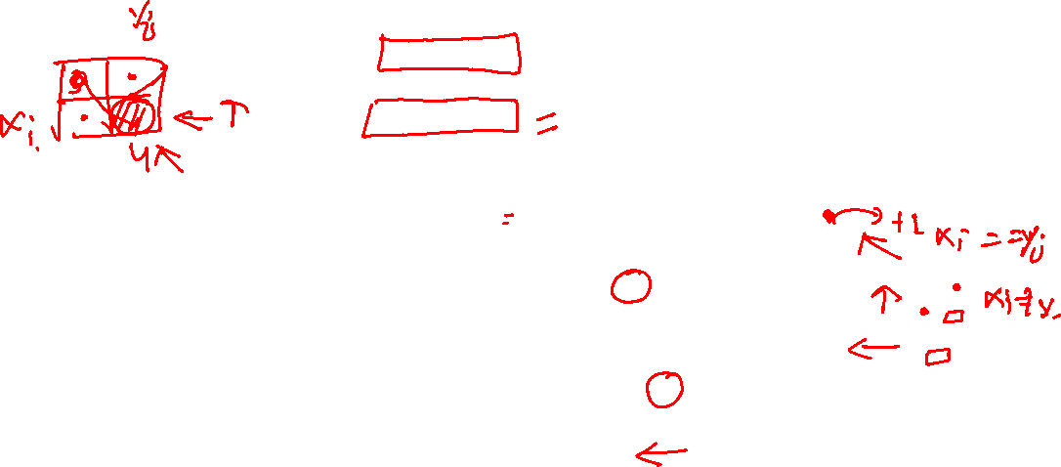
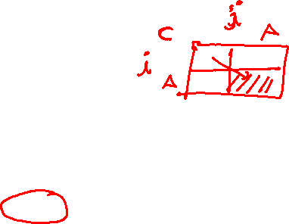

Slide 19
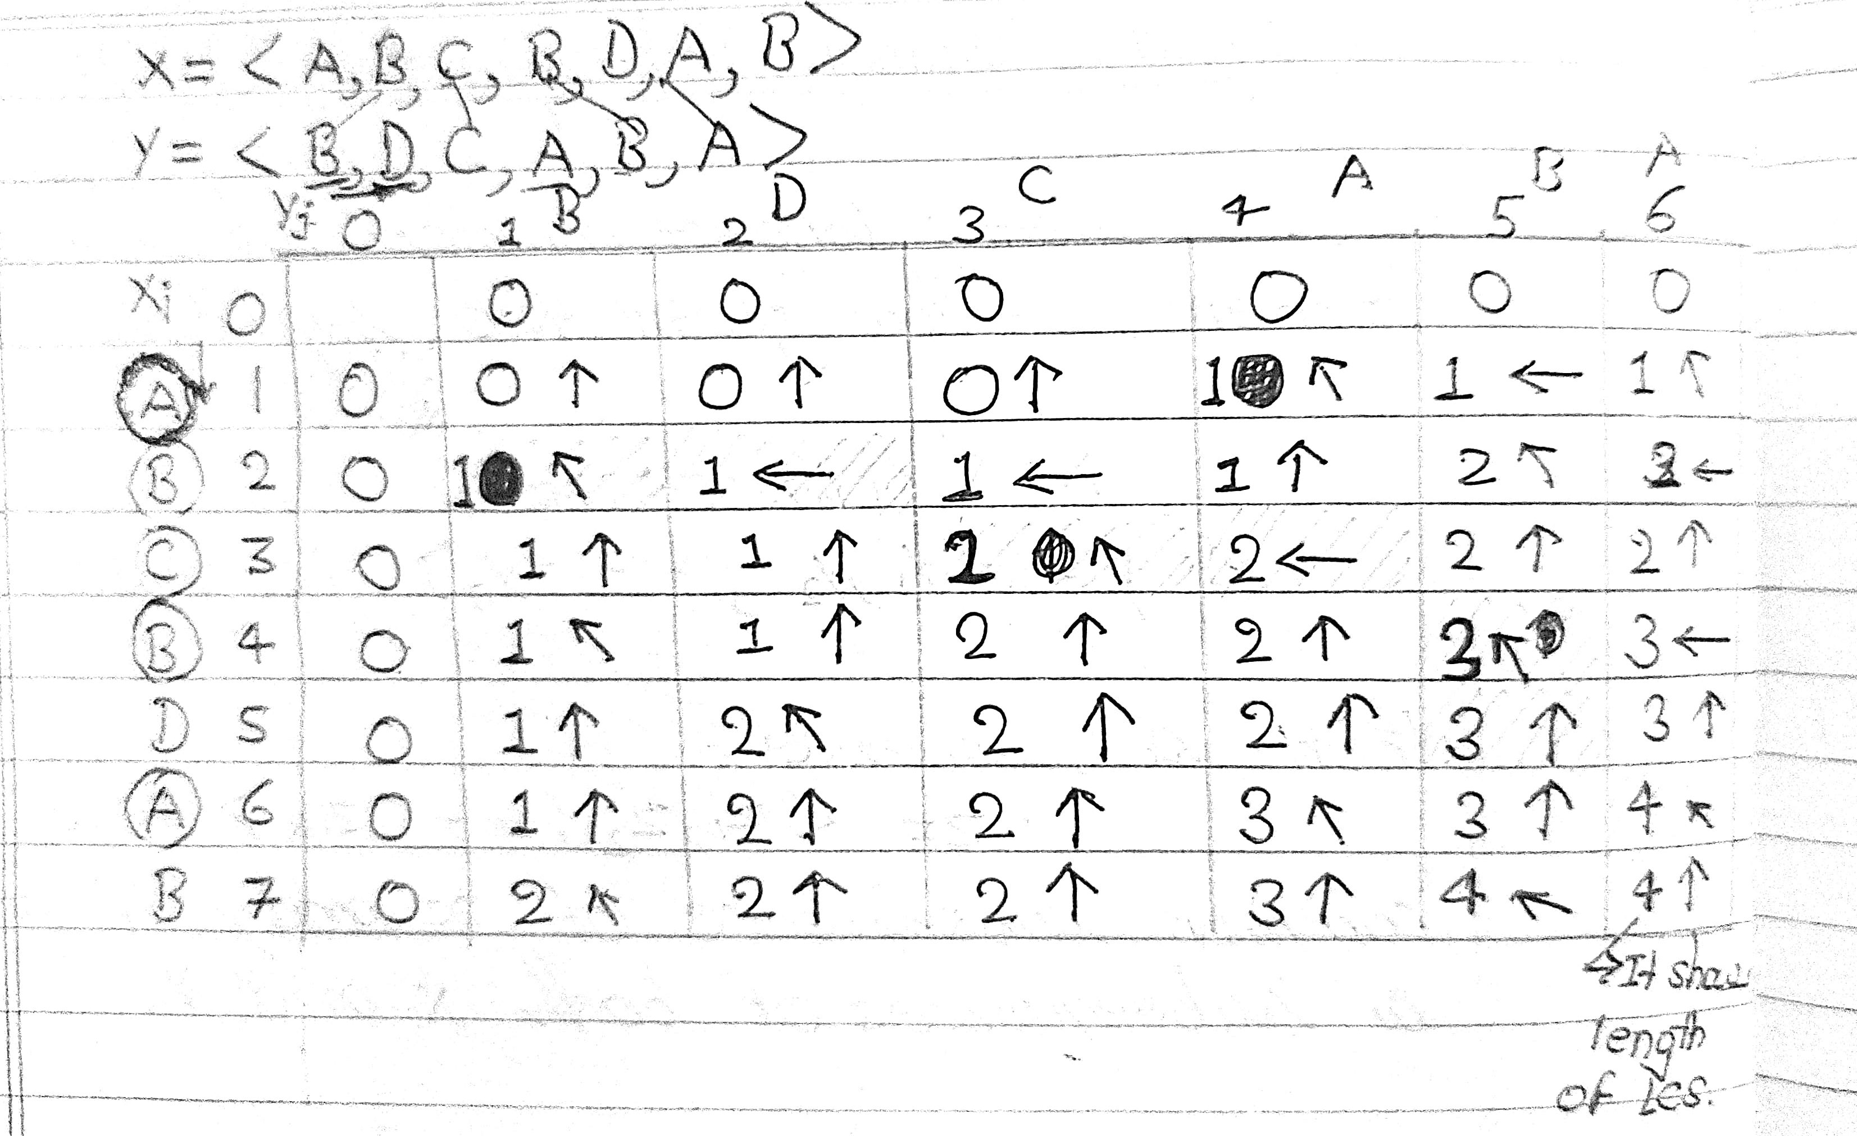




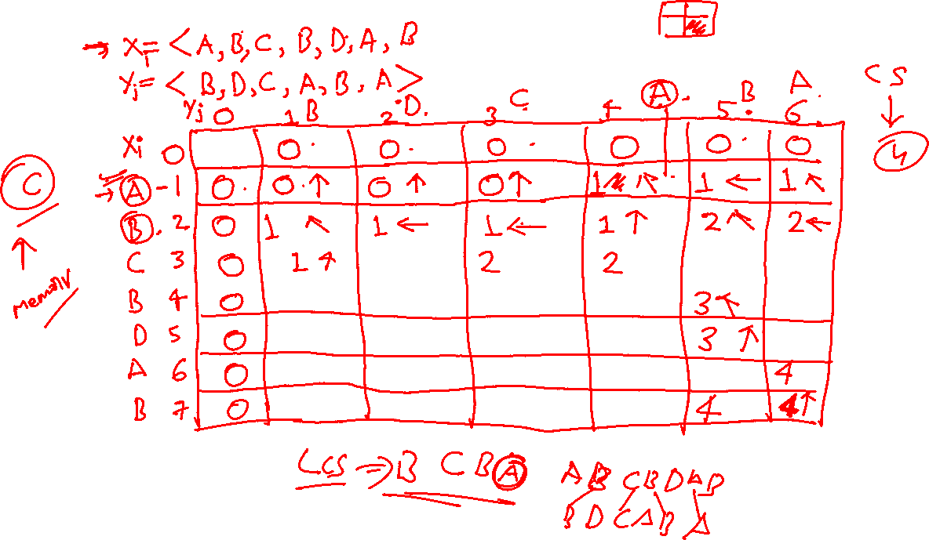





Slide 20
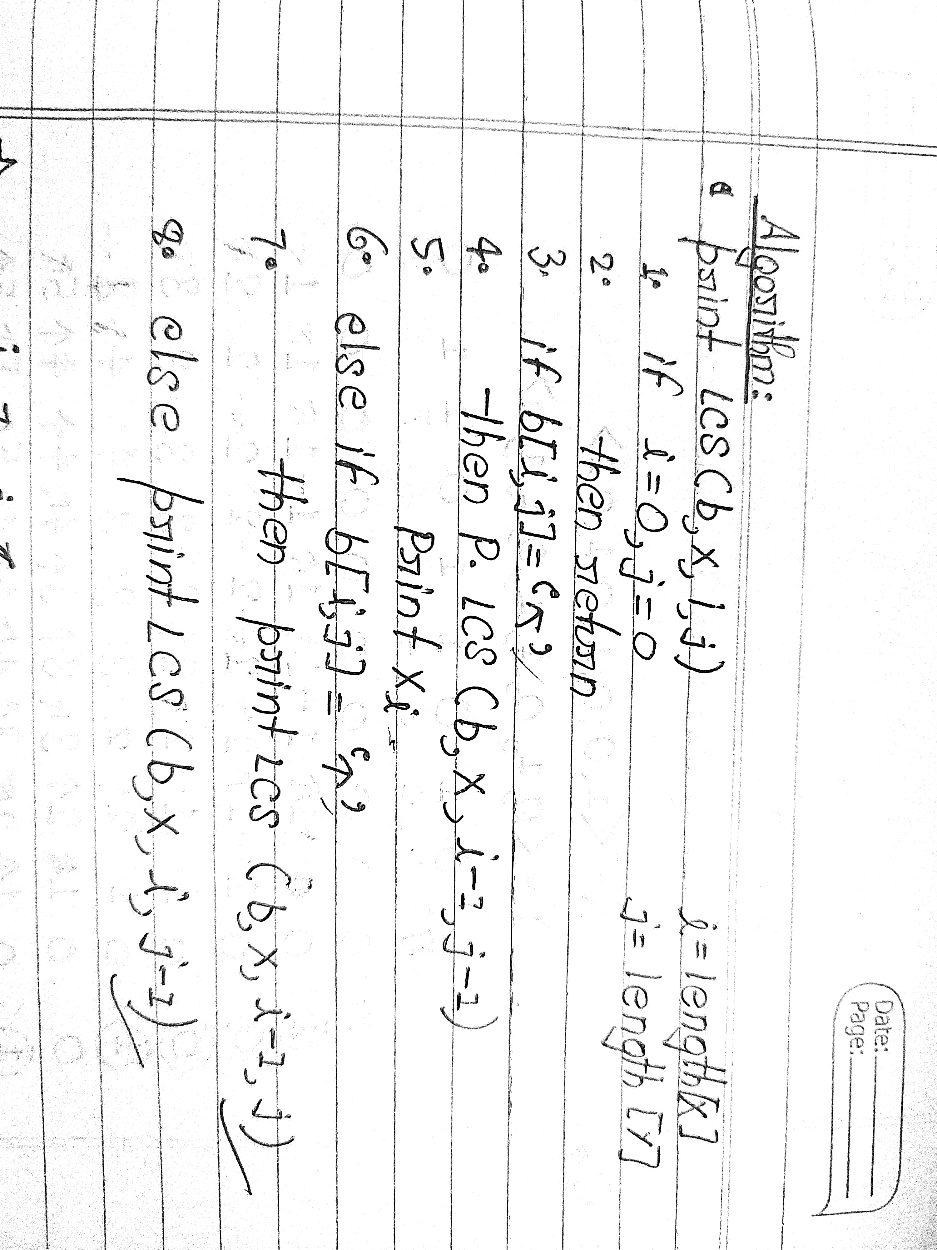
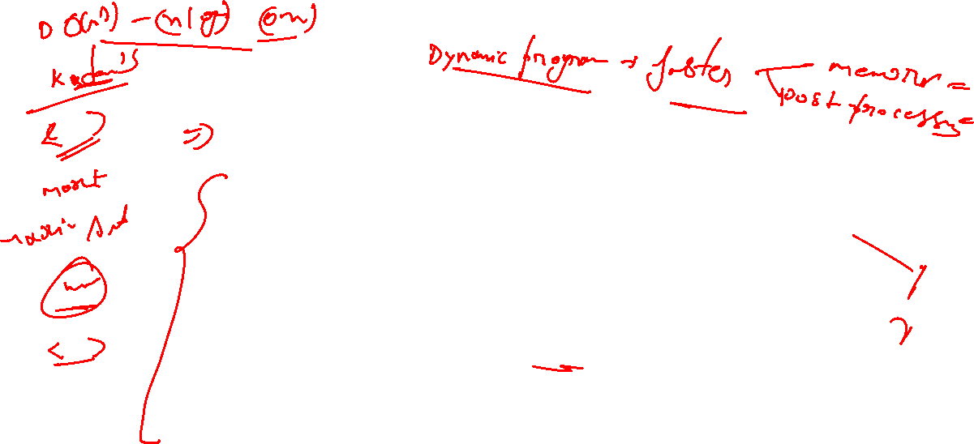

Slide 21
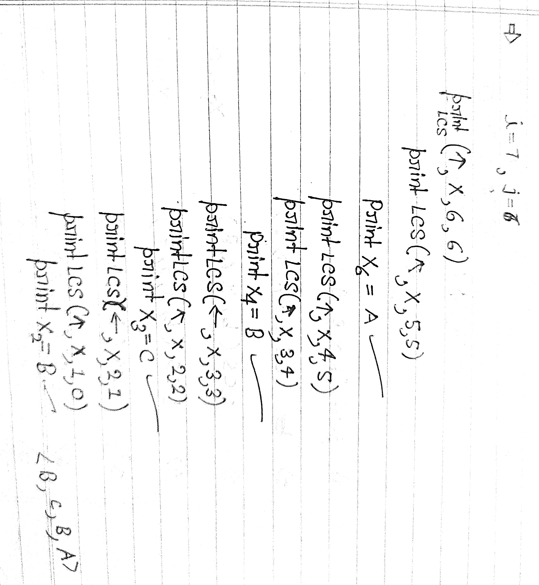

Slide 22
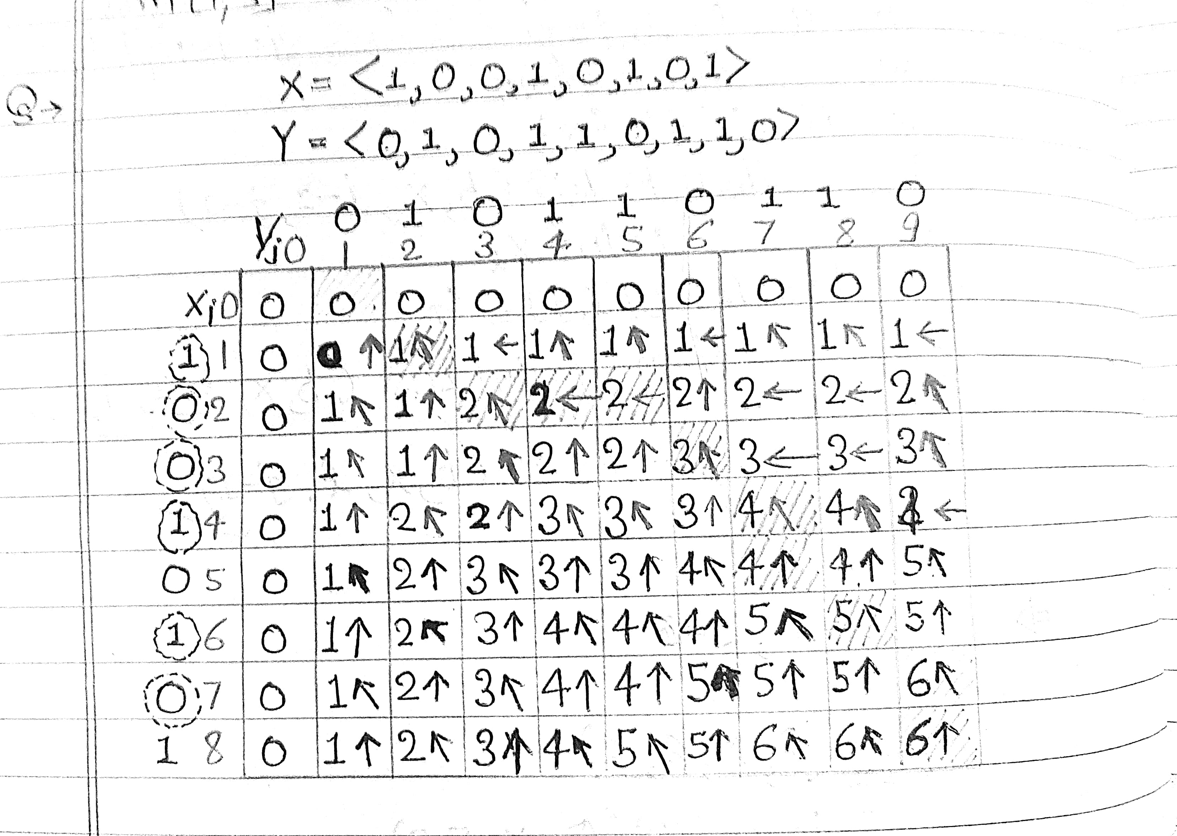

Slide 23
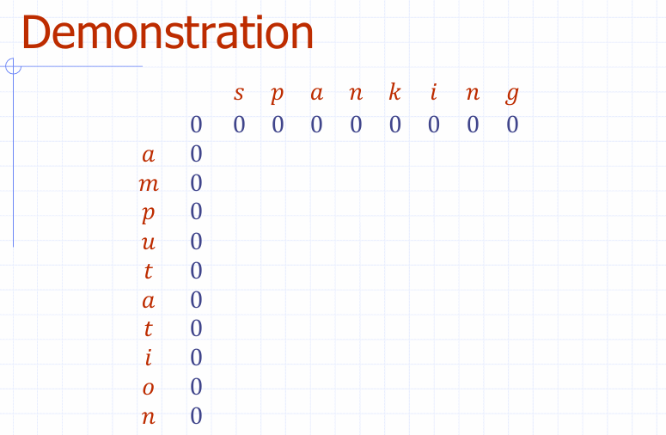

Slide 24
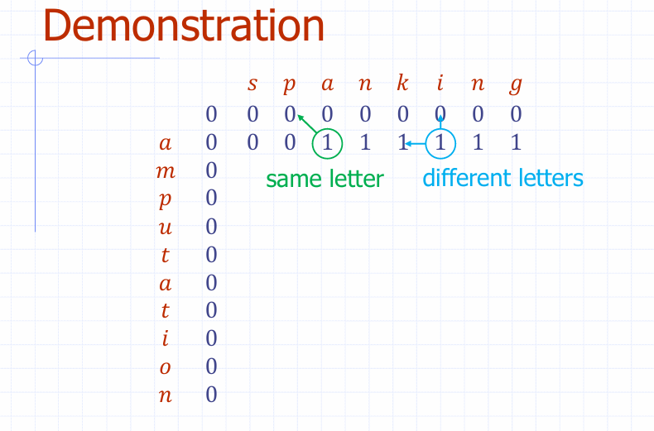

Slide 25
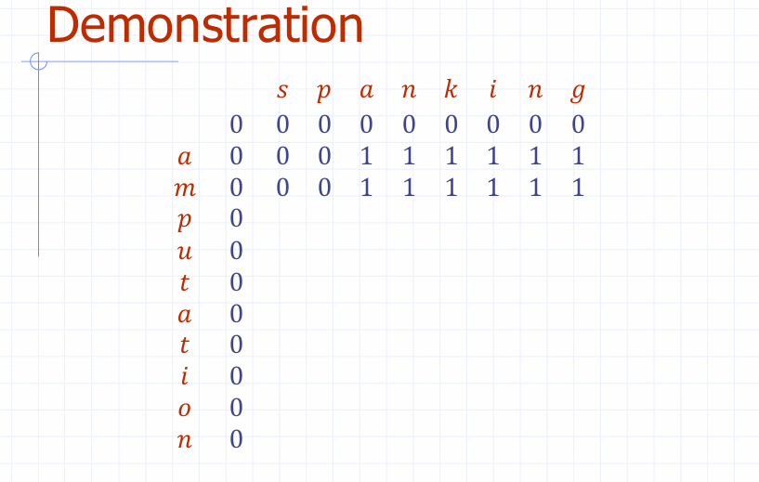

Slide 26
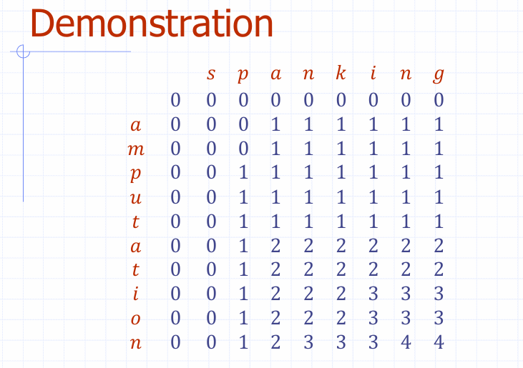

Slide 27
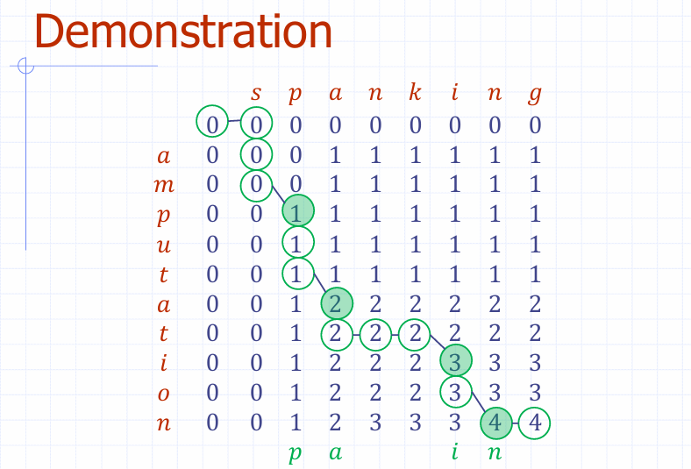

Slide 28
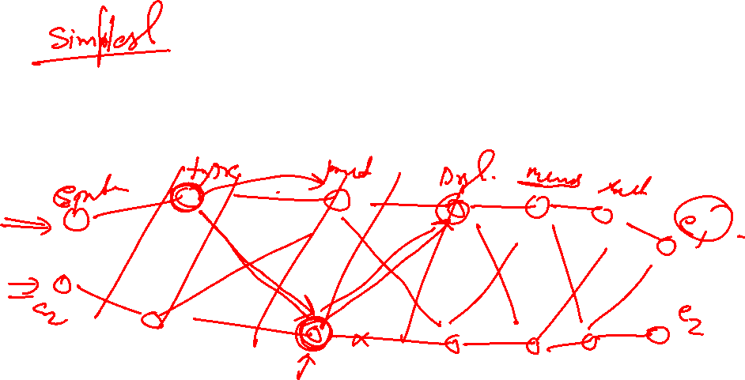
Assembly Line Scheduling

Slide 29
Introduction
Overview of assembly line scheduling
Importance in manufacturing
Objectives: Minimize production time and costs

Slide 30
Key Concepts
Assembly Line Balancing
Workstations and Tasks
Cycle Time
Idle Time and Bottlenecks

Slide 31
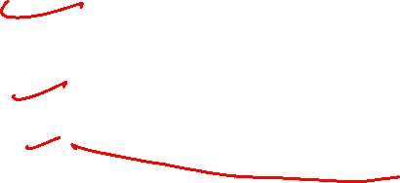
Scheduling Algorithms
Heuristic Methods
Genetic Algorithms
Dynamic Programming
Mixed-Model Assembly Line Scheduling

Slide 32
Challenges in Assembly Line Scheduling
Managing variability in tasks
synchronization between workstations
Adapting to product variety
Reducing downtime and inefficiencies

Slide 33
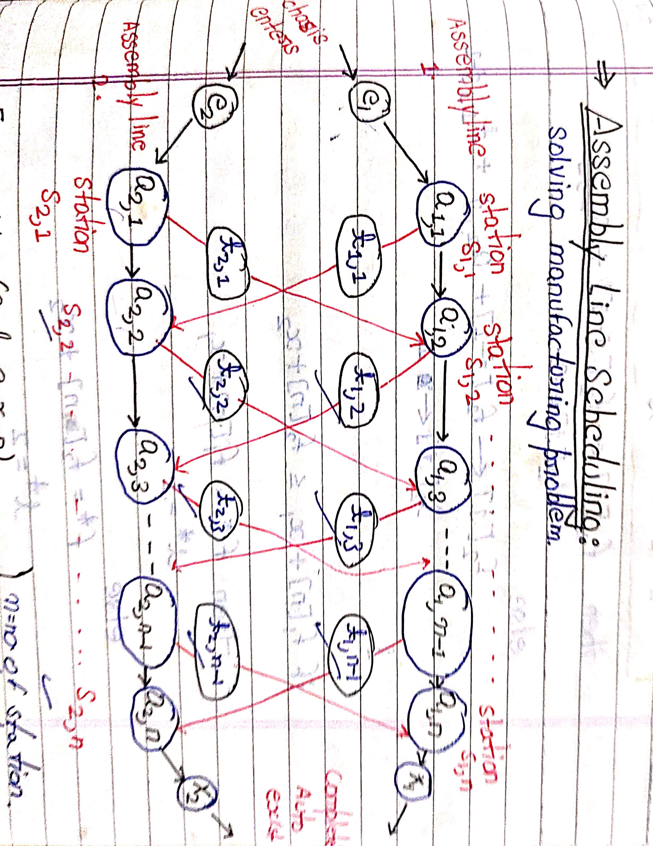
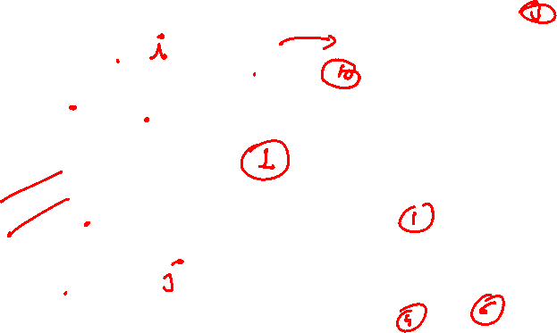

Slide 34
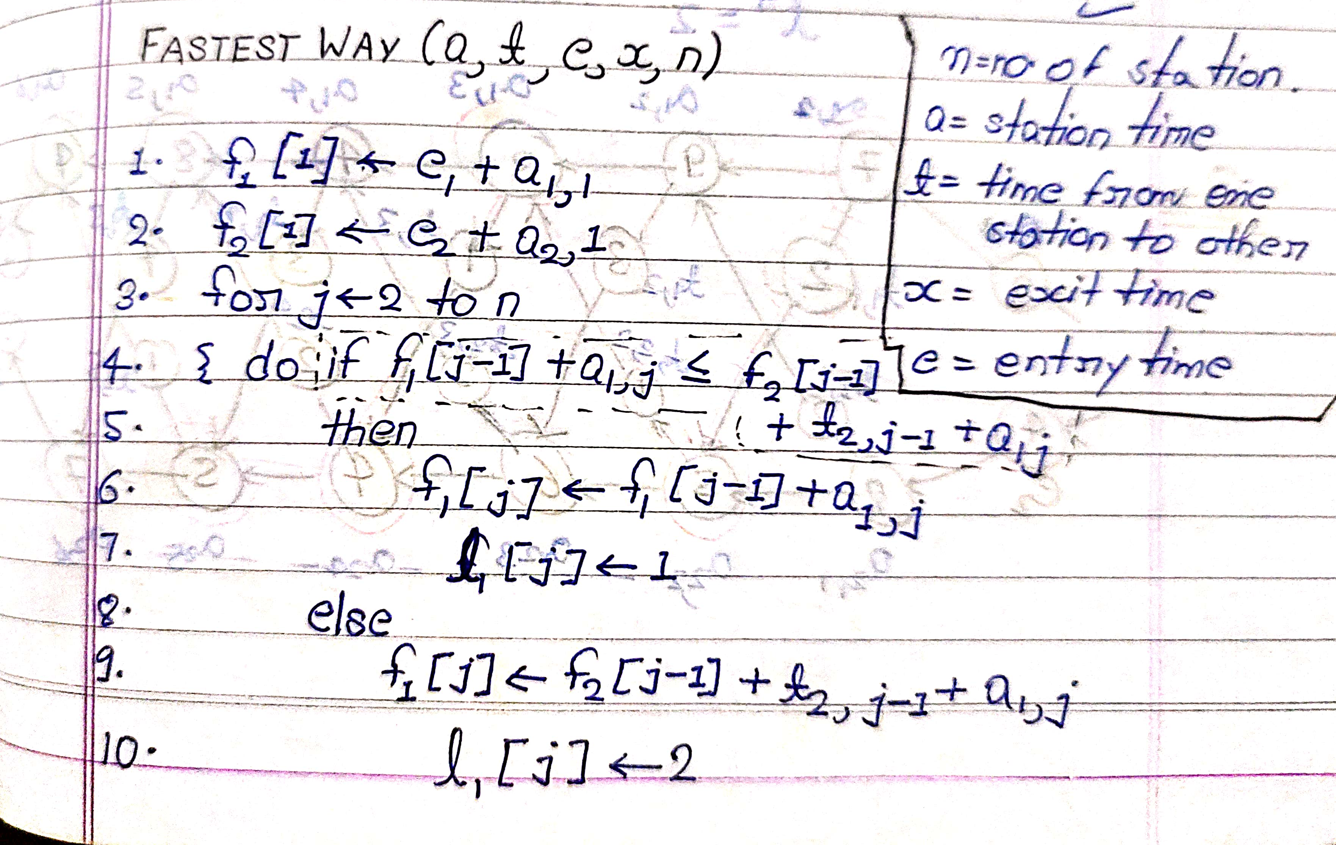
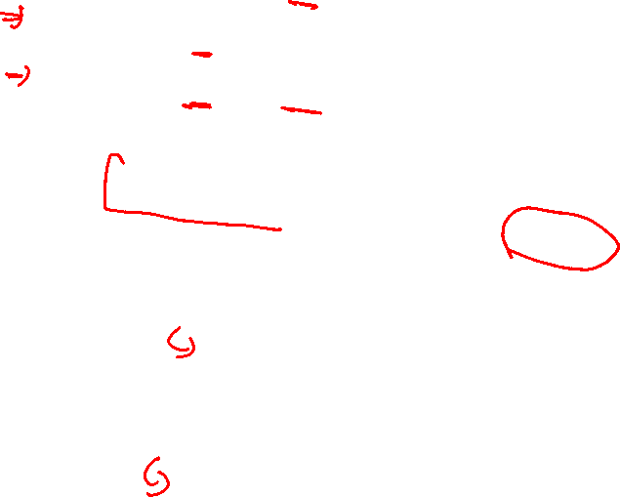

Slide 35
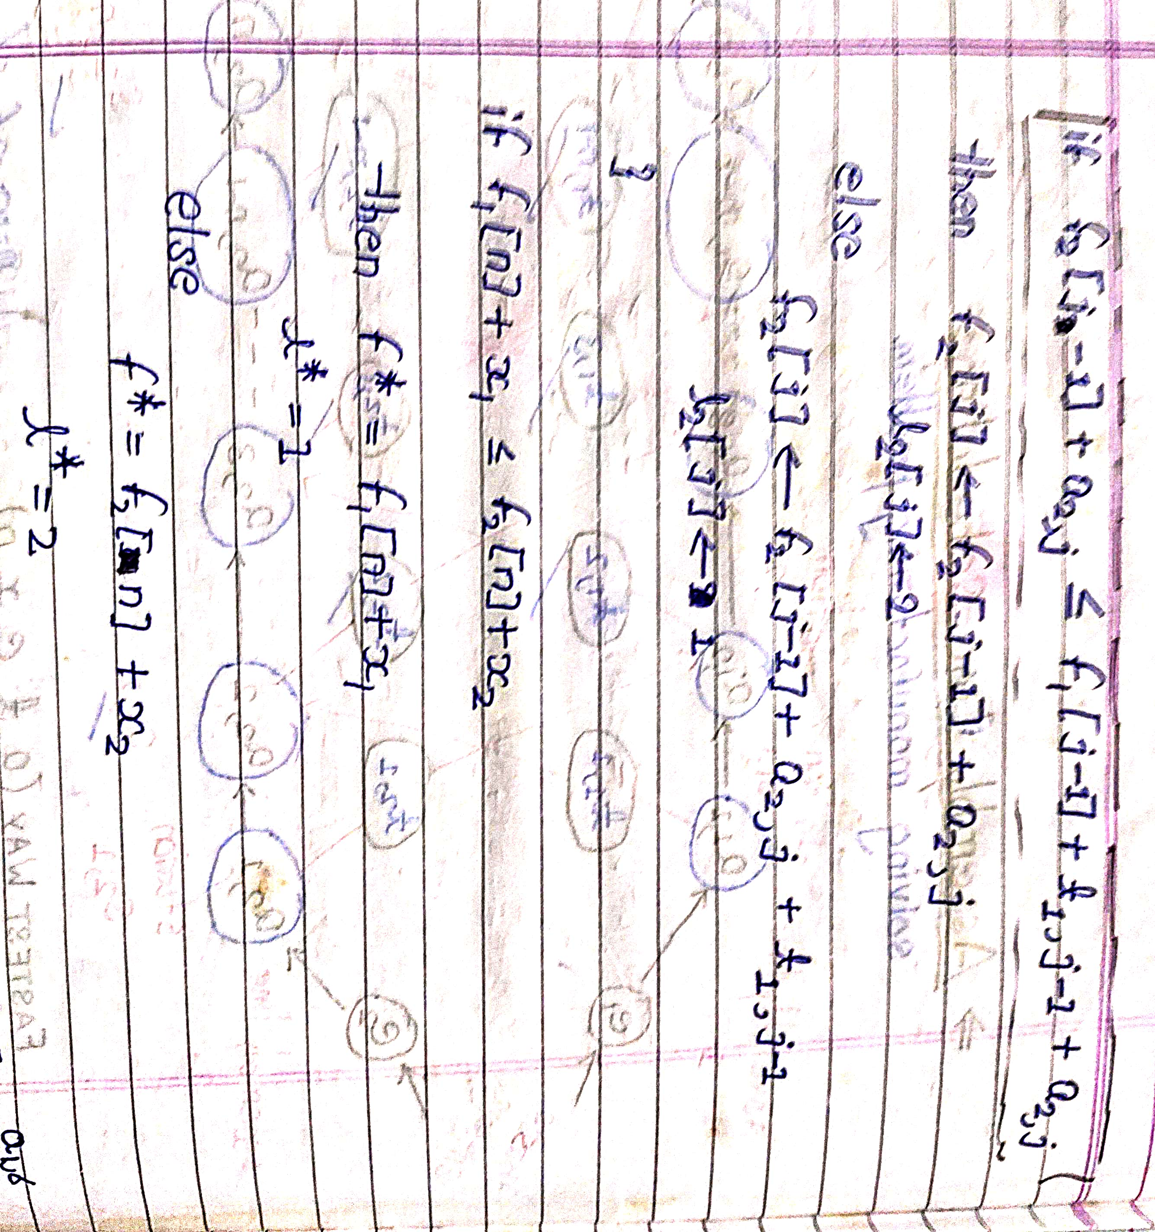

Slide 36
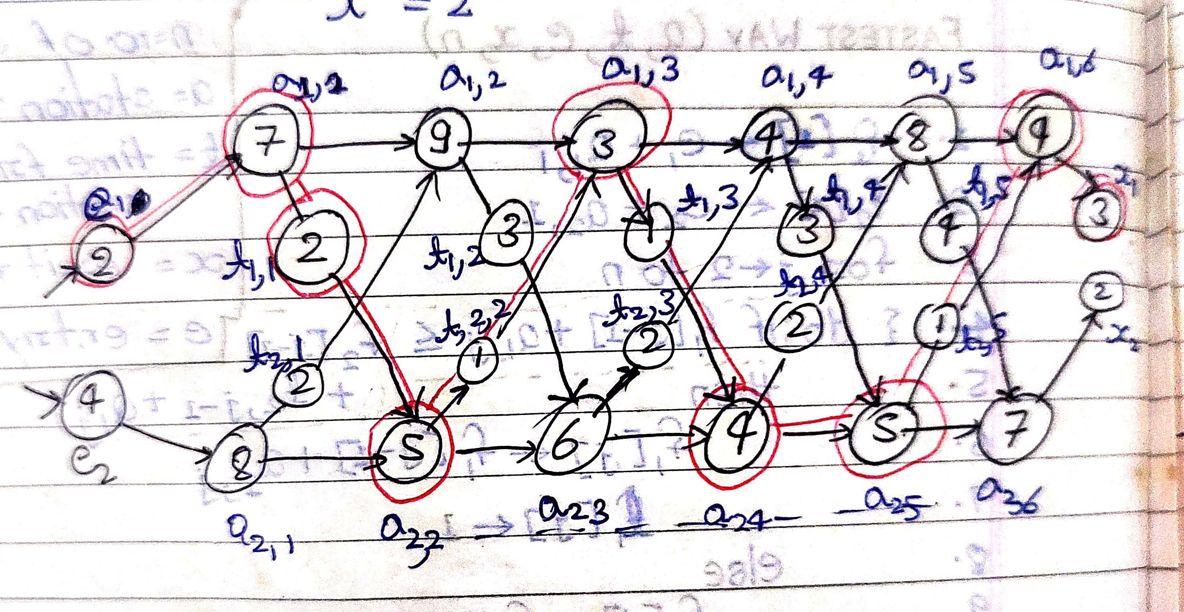
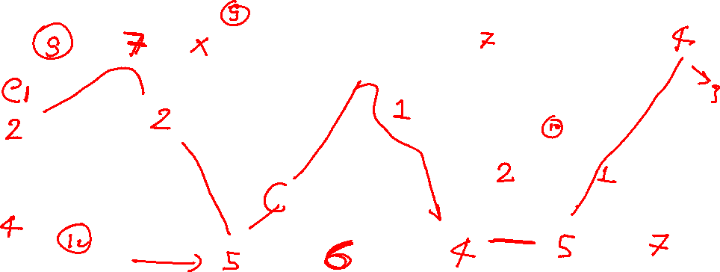
7

Slide 37
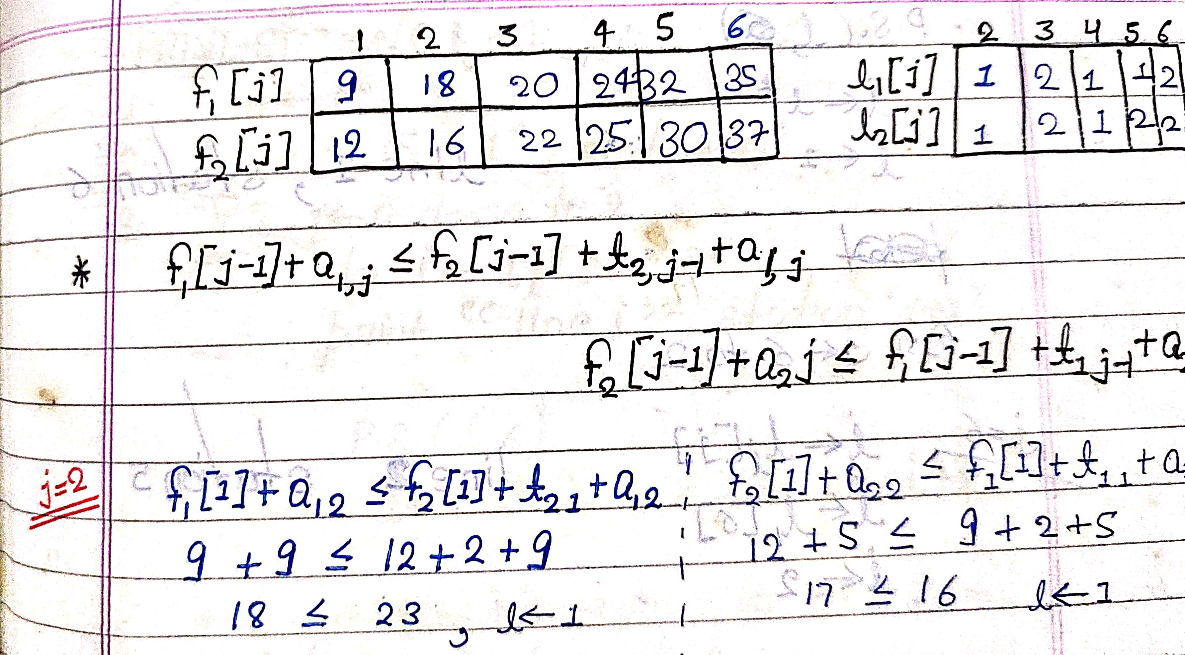
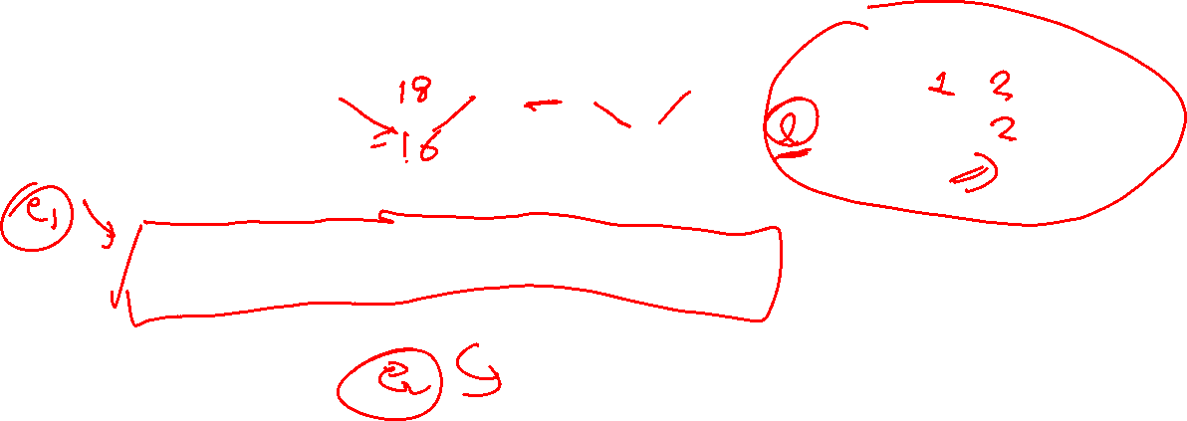

Slide 38
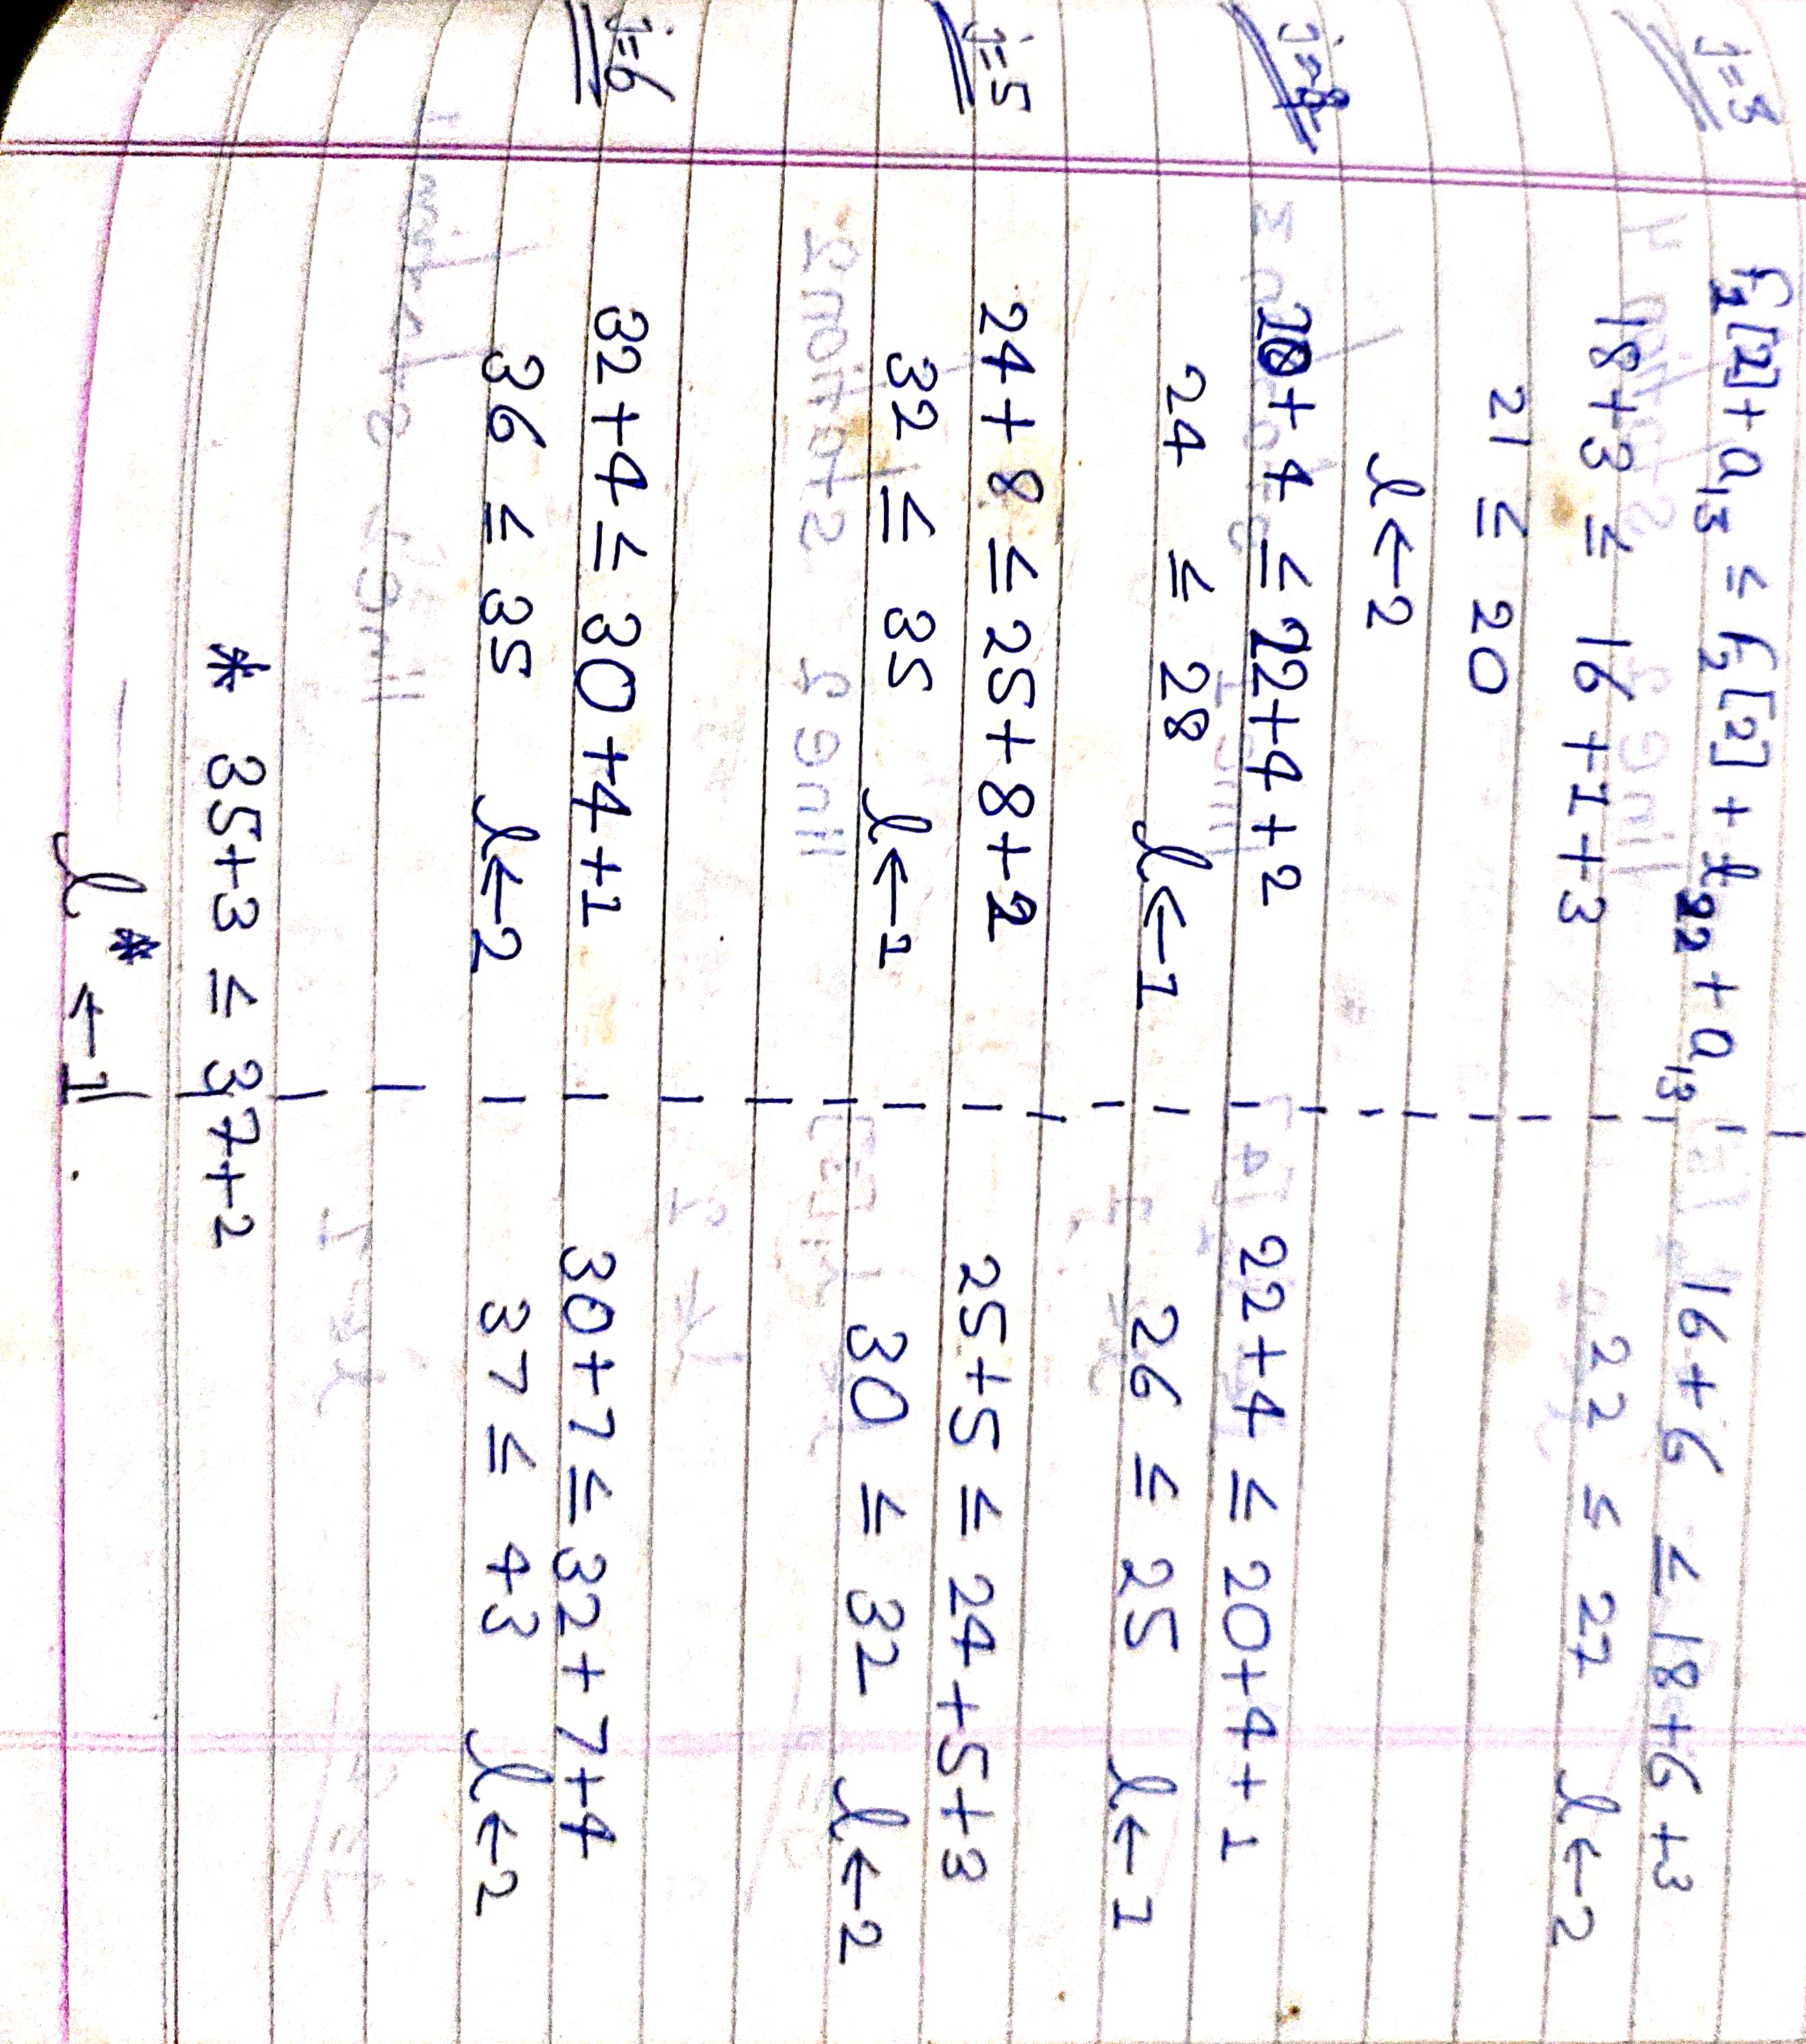

Slide 39
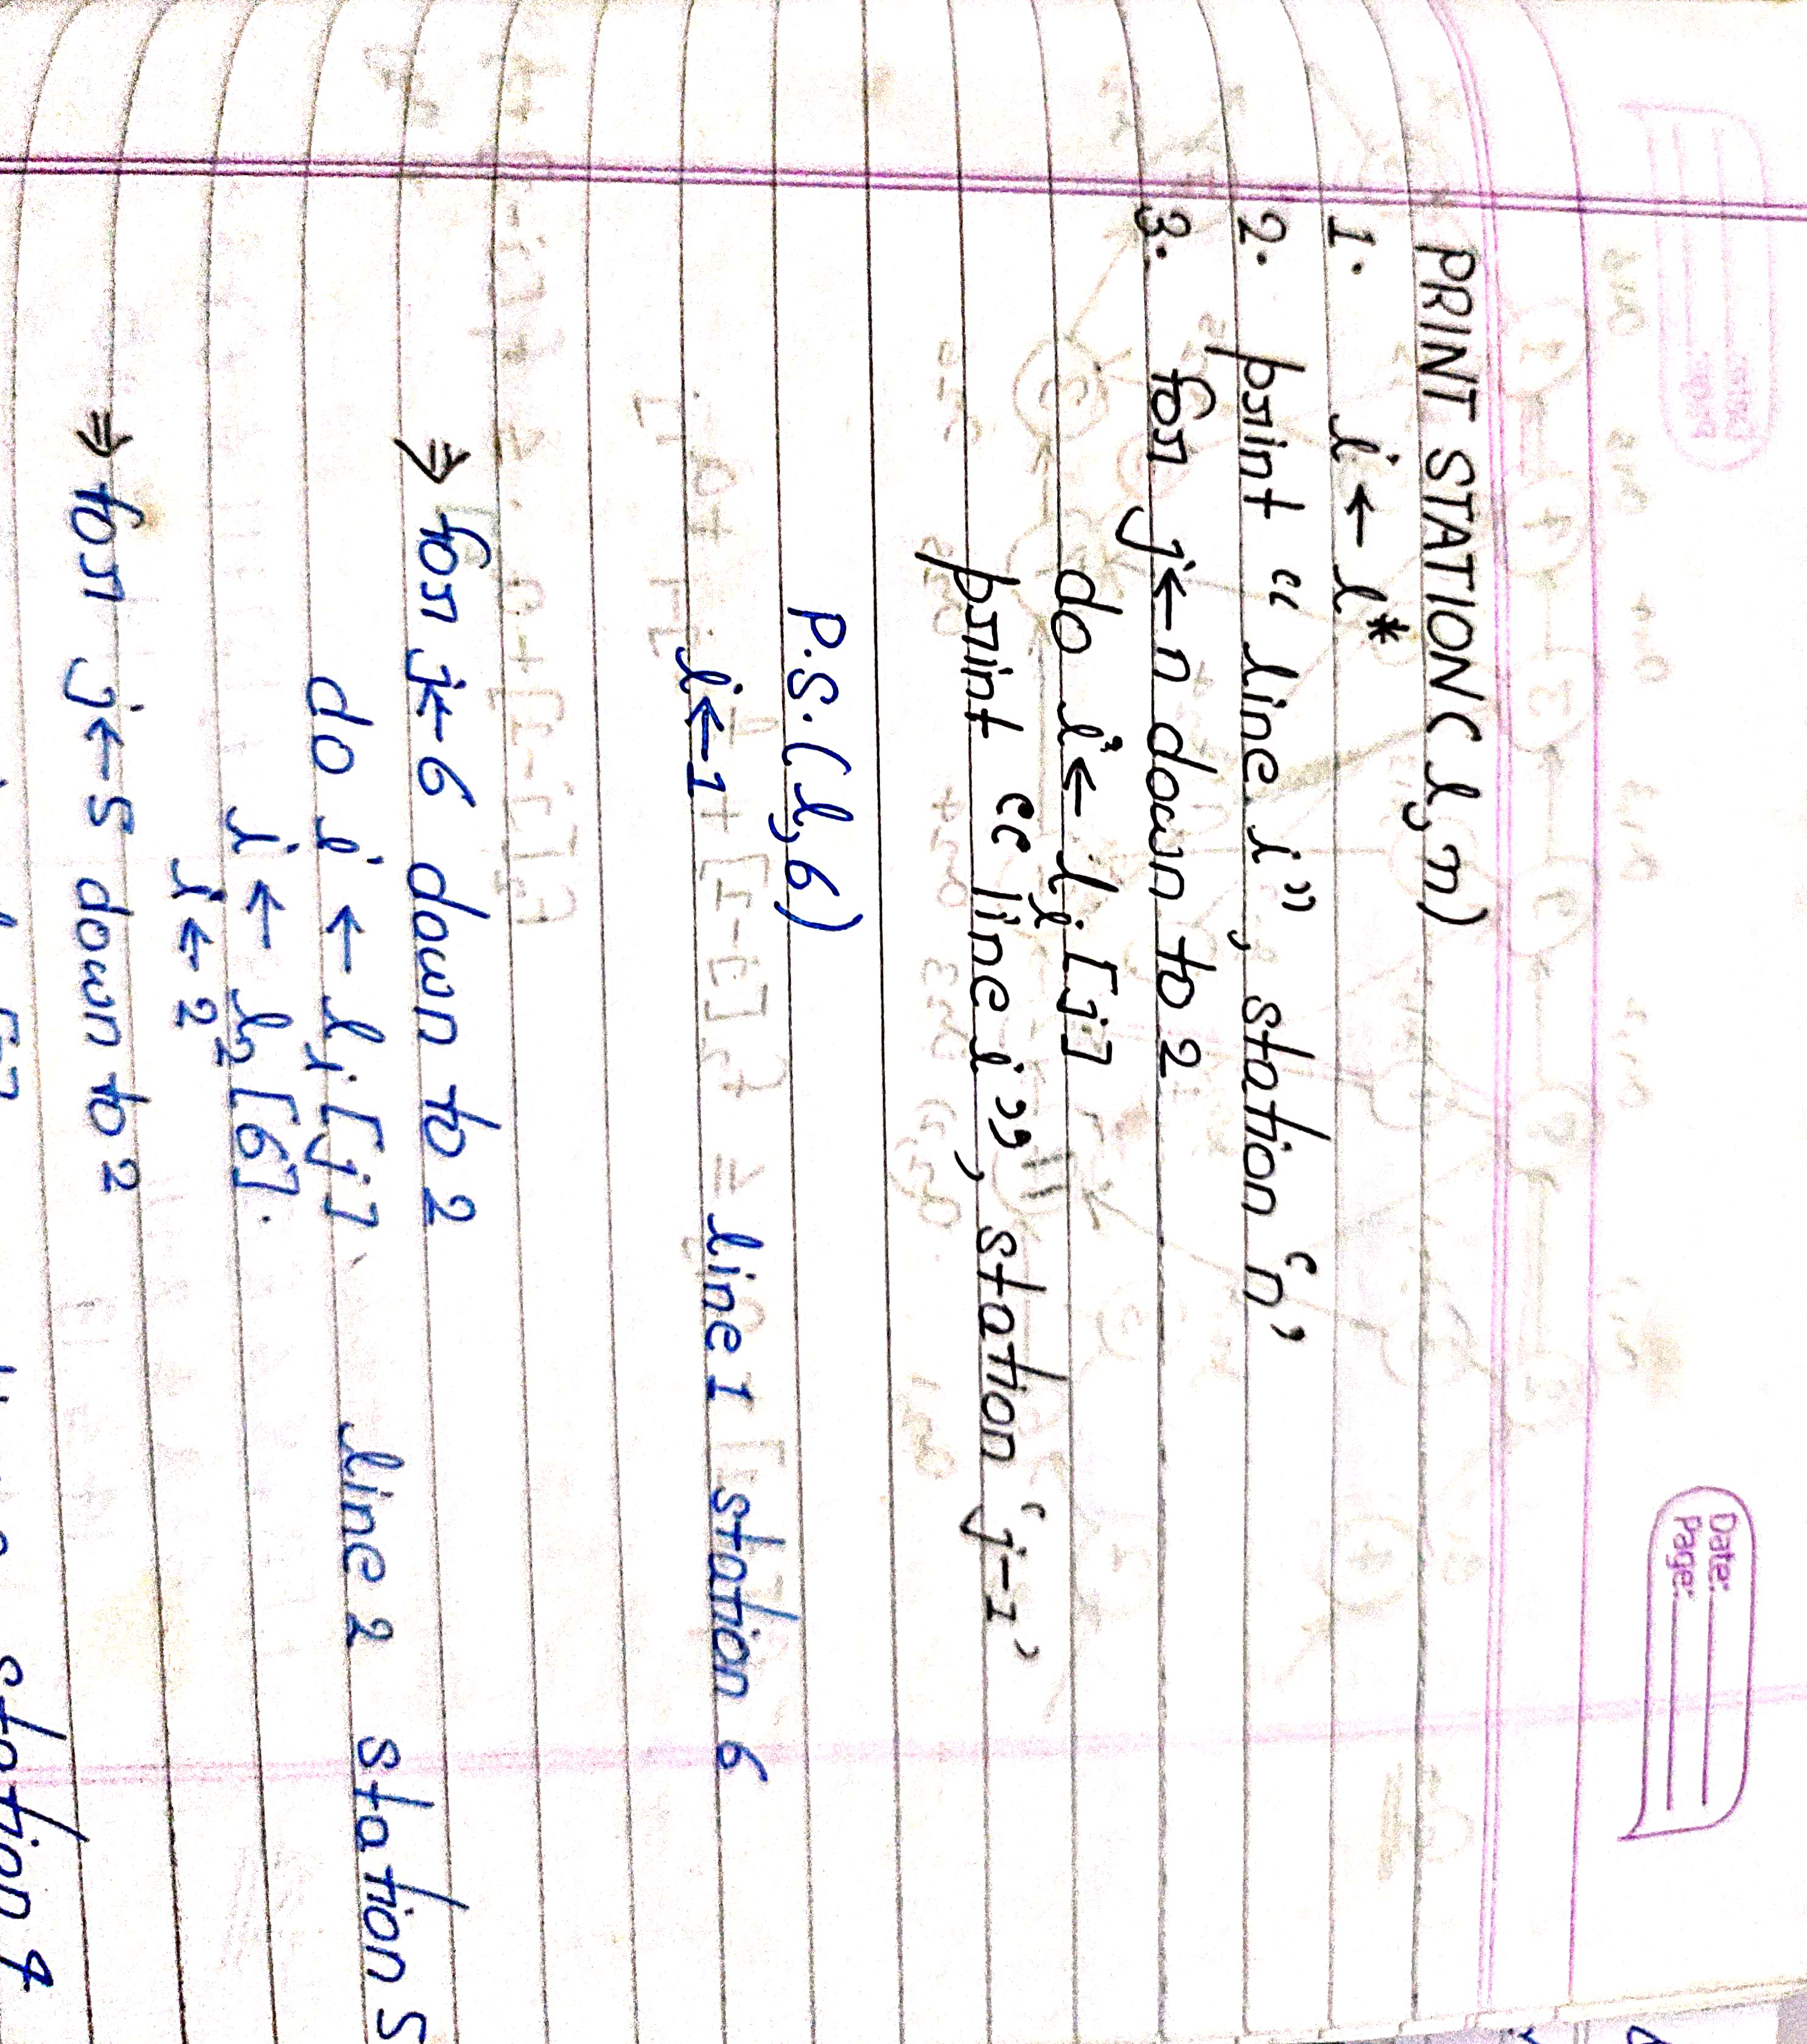

Slide 40
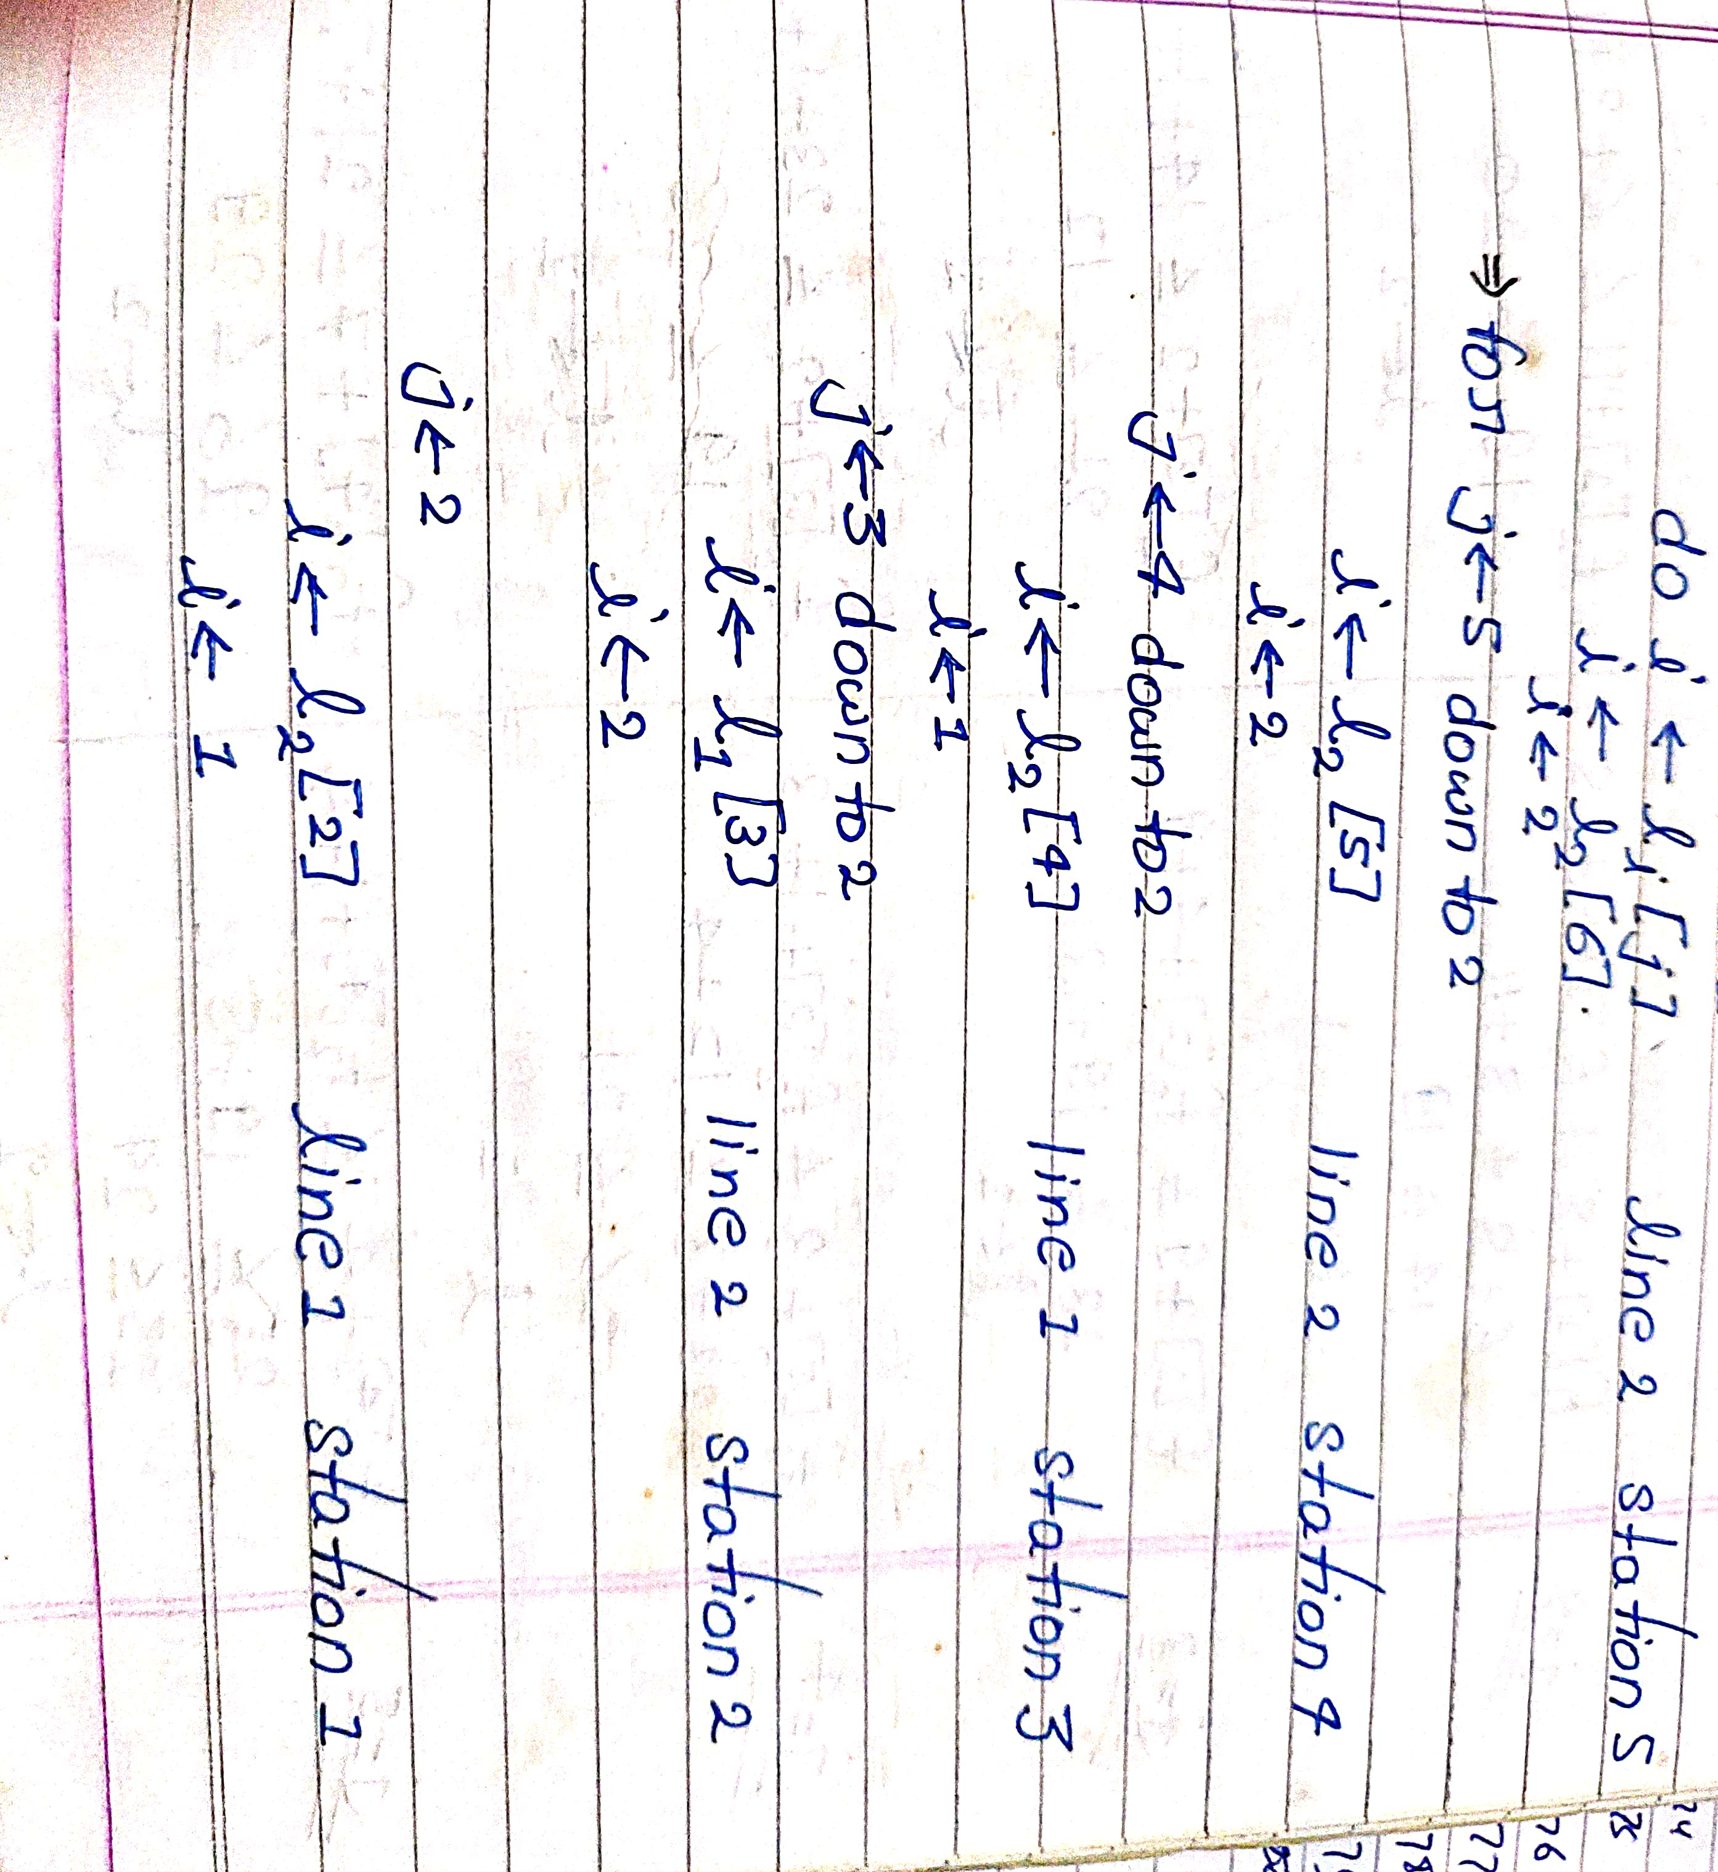

Slide 41
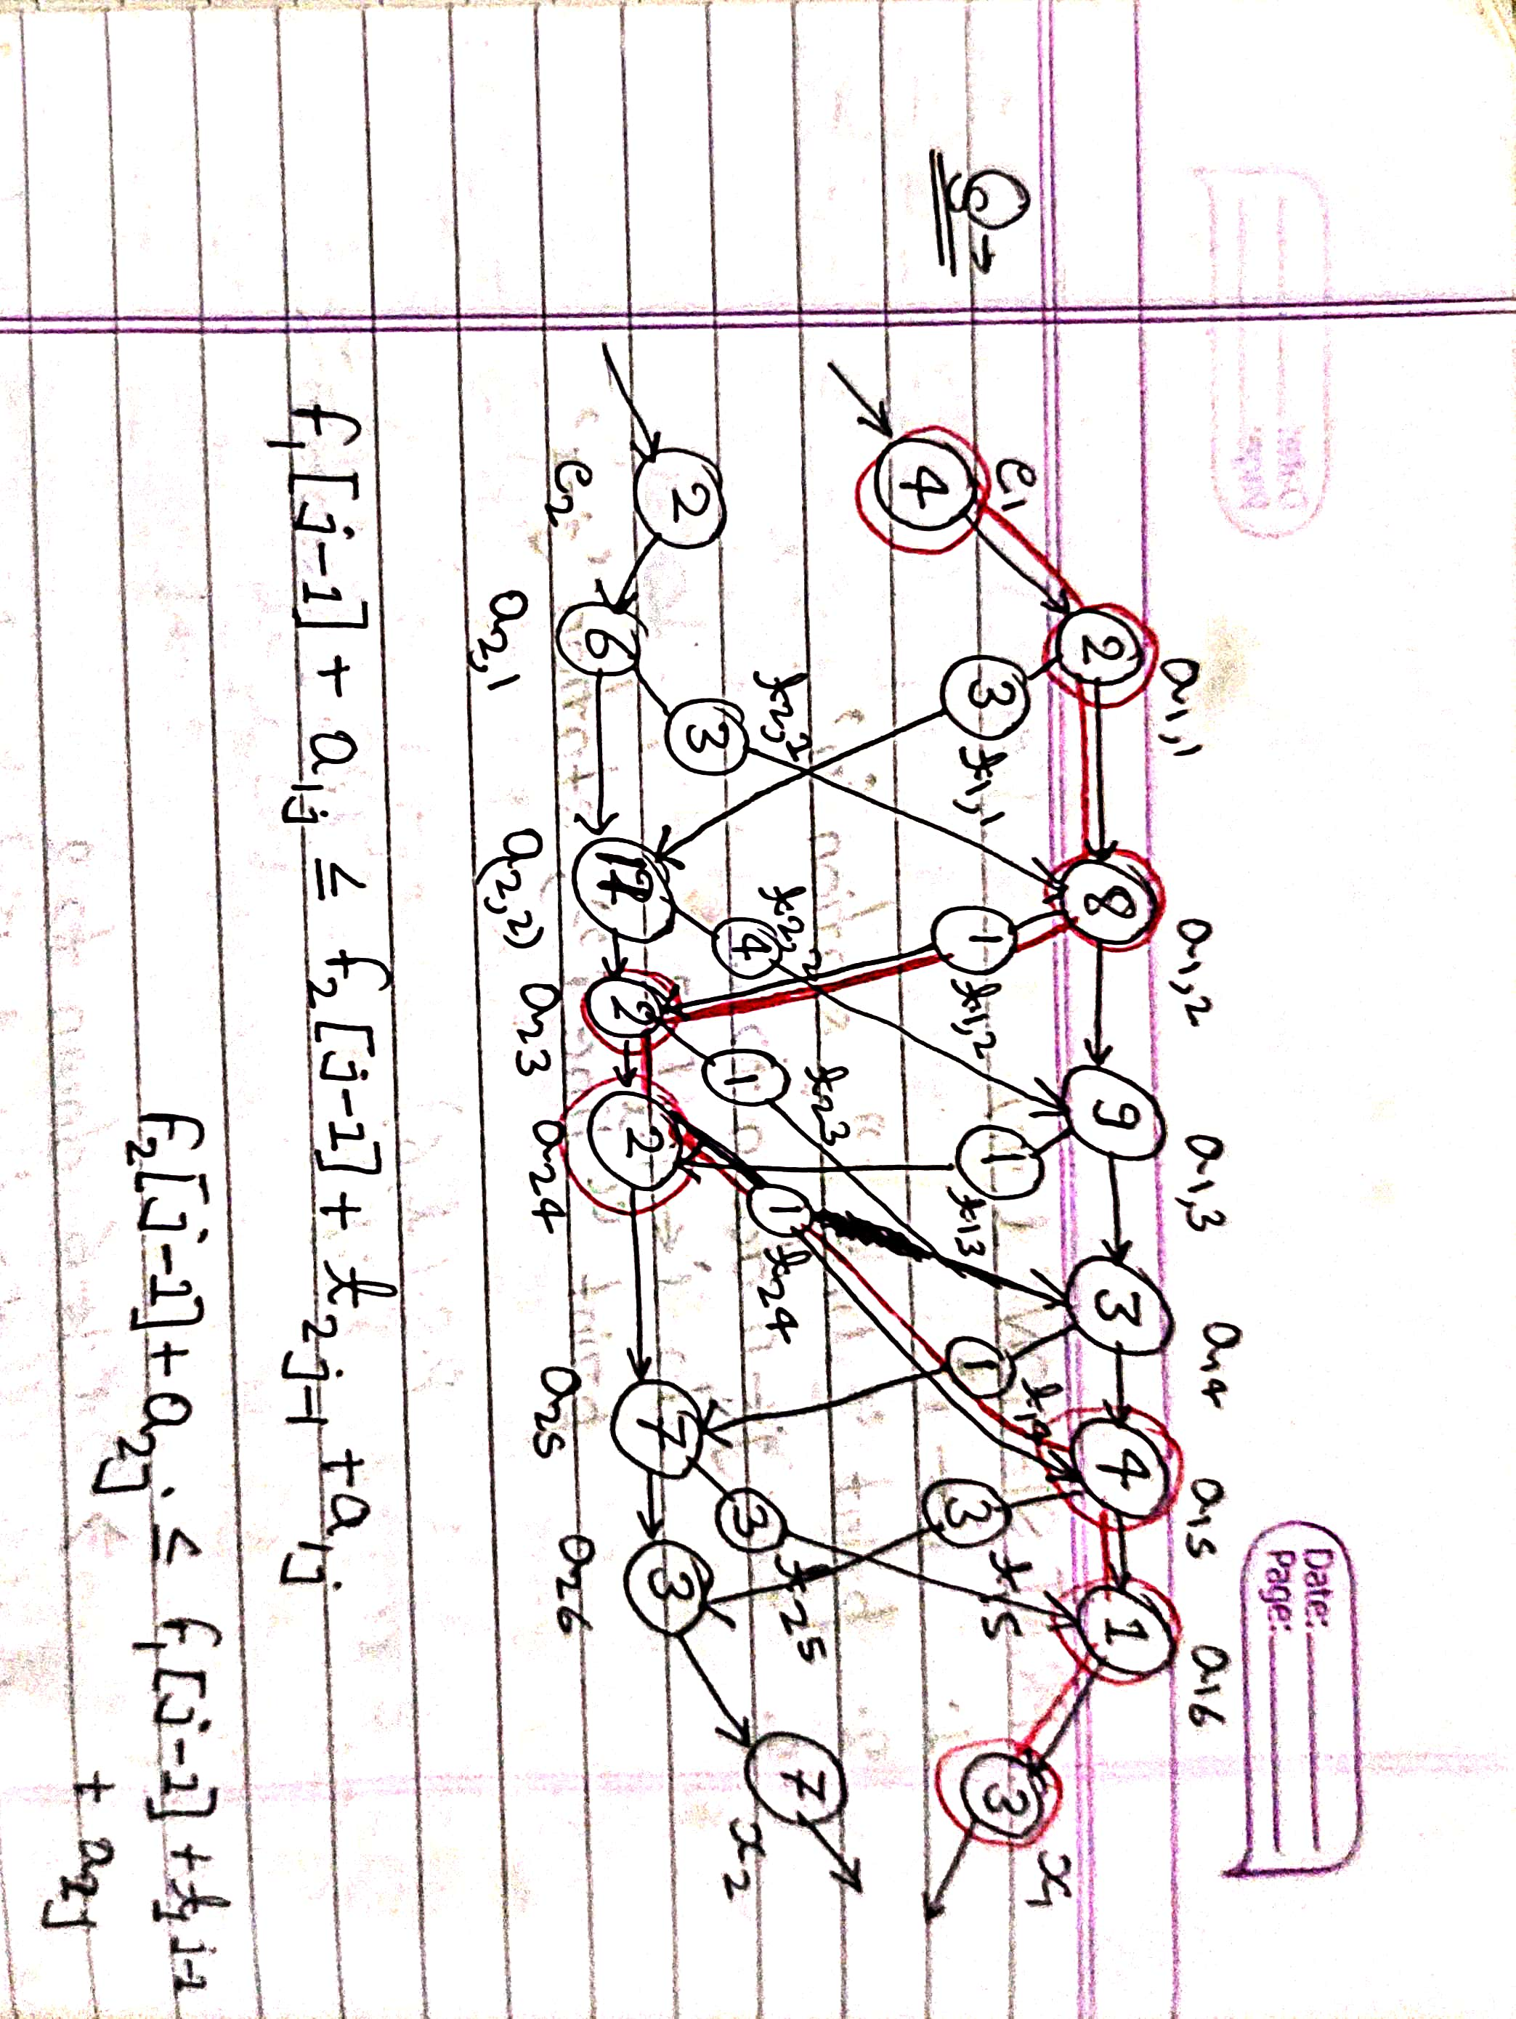

Slide 42
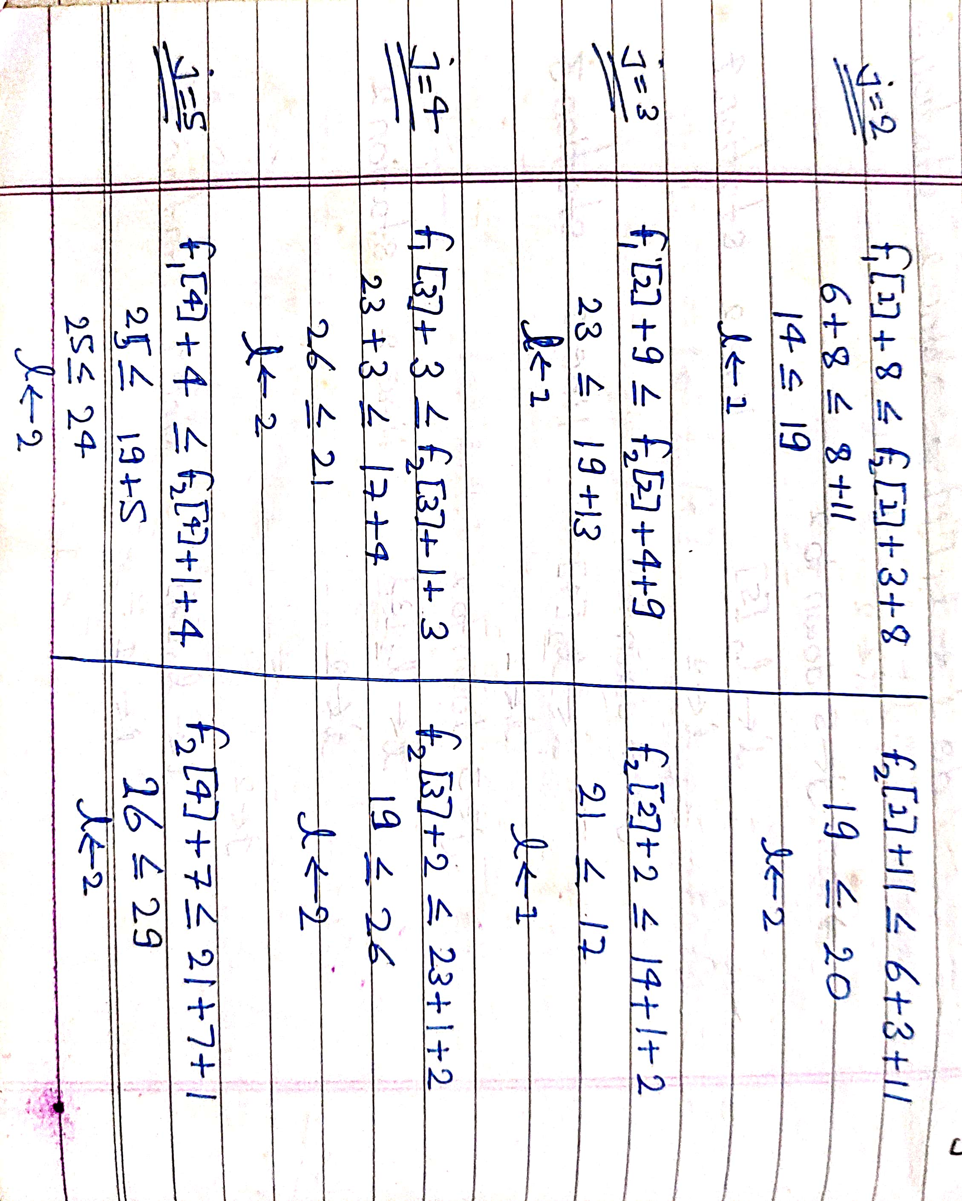

Slide 43
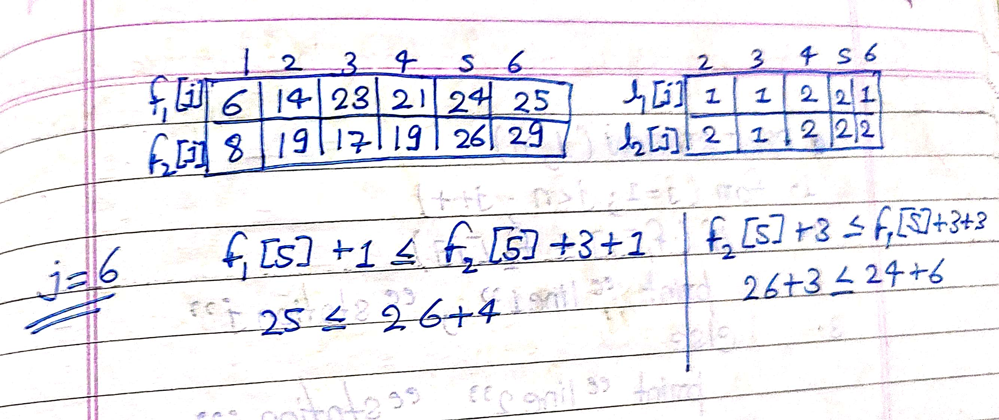

Slide 44
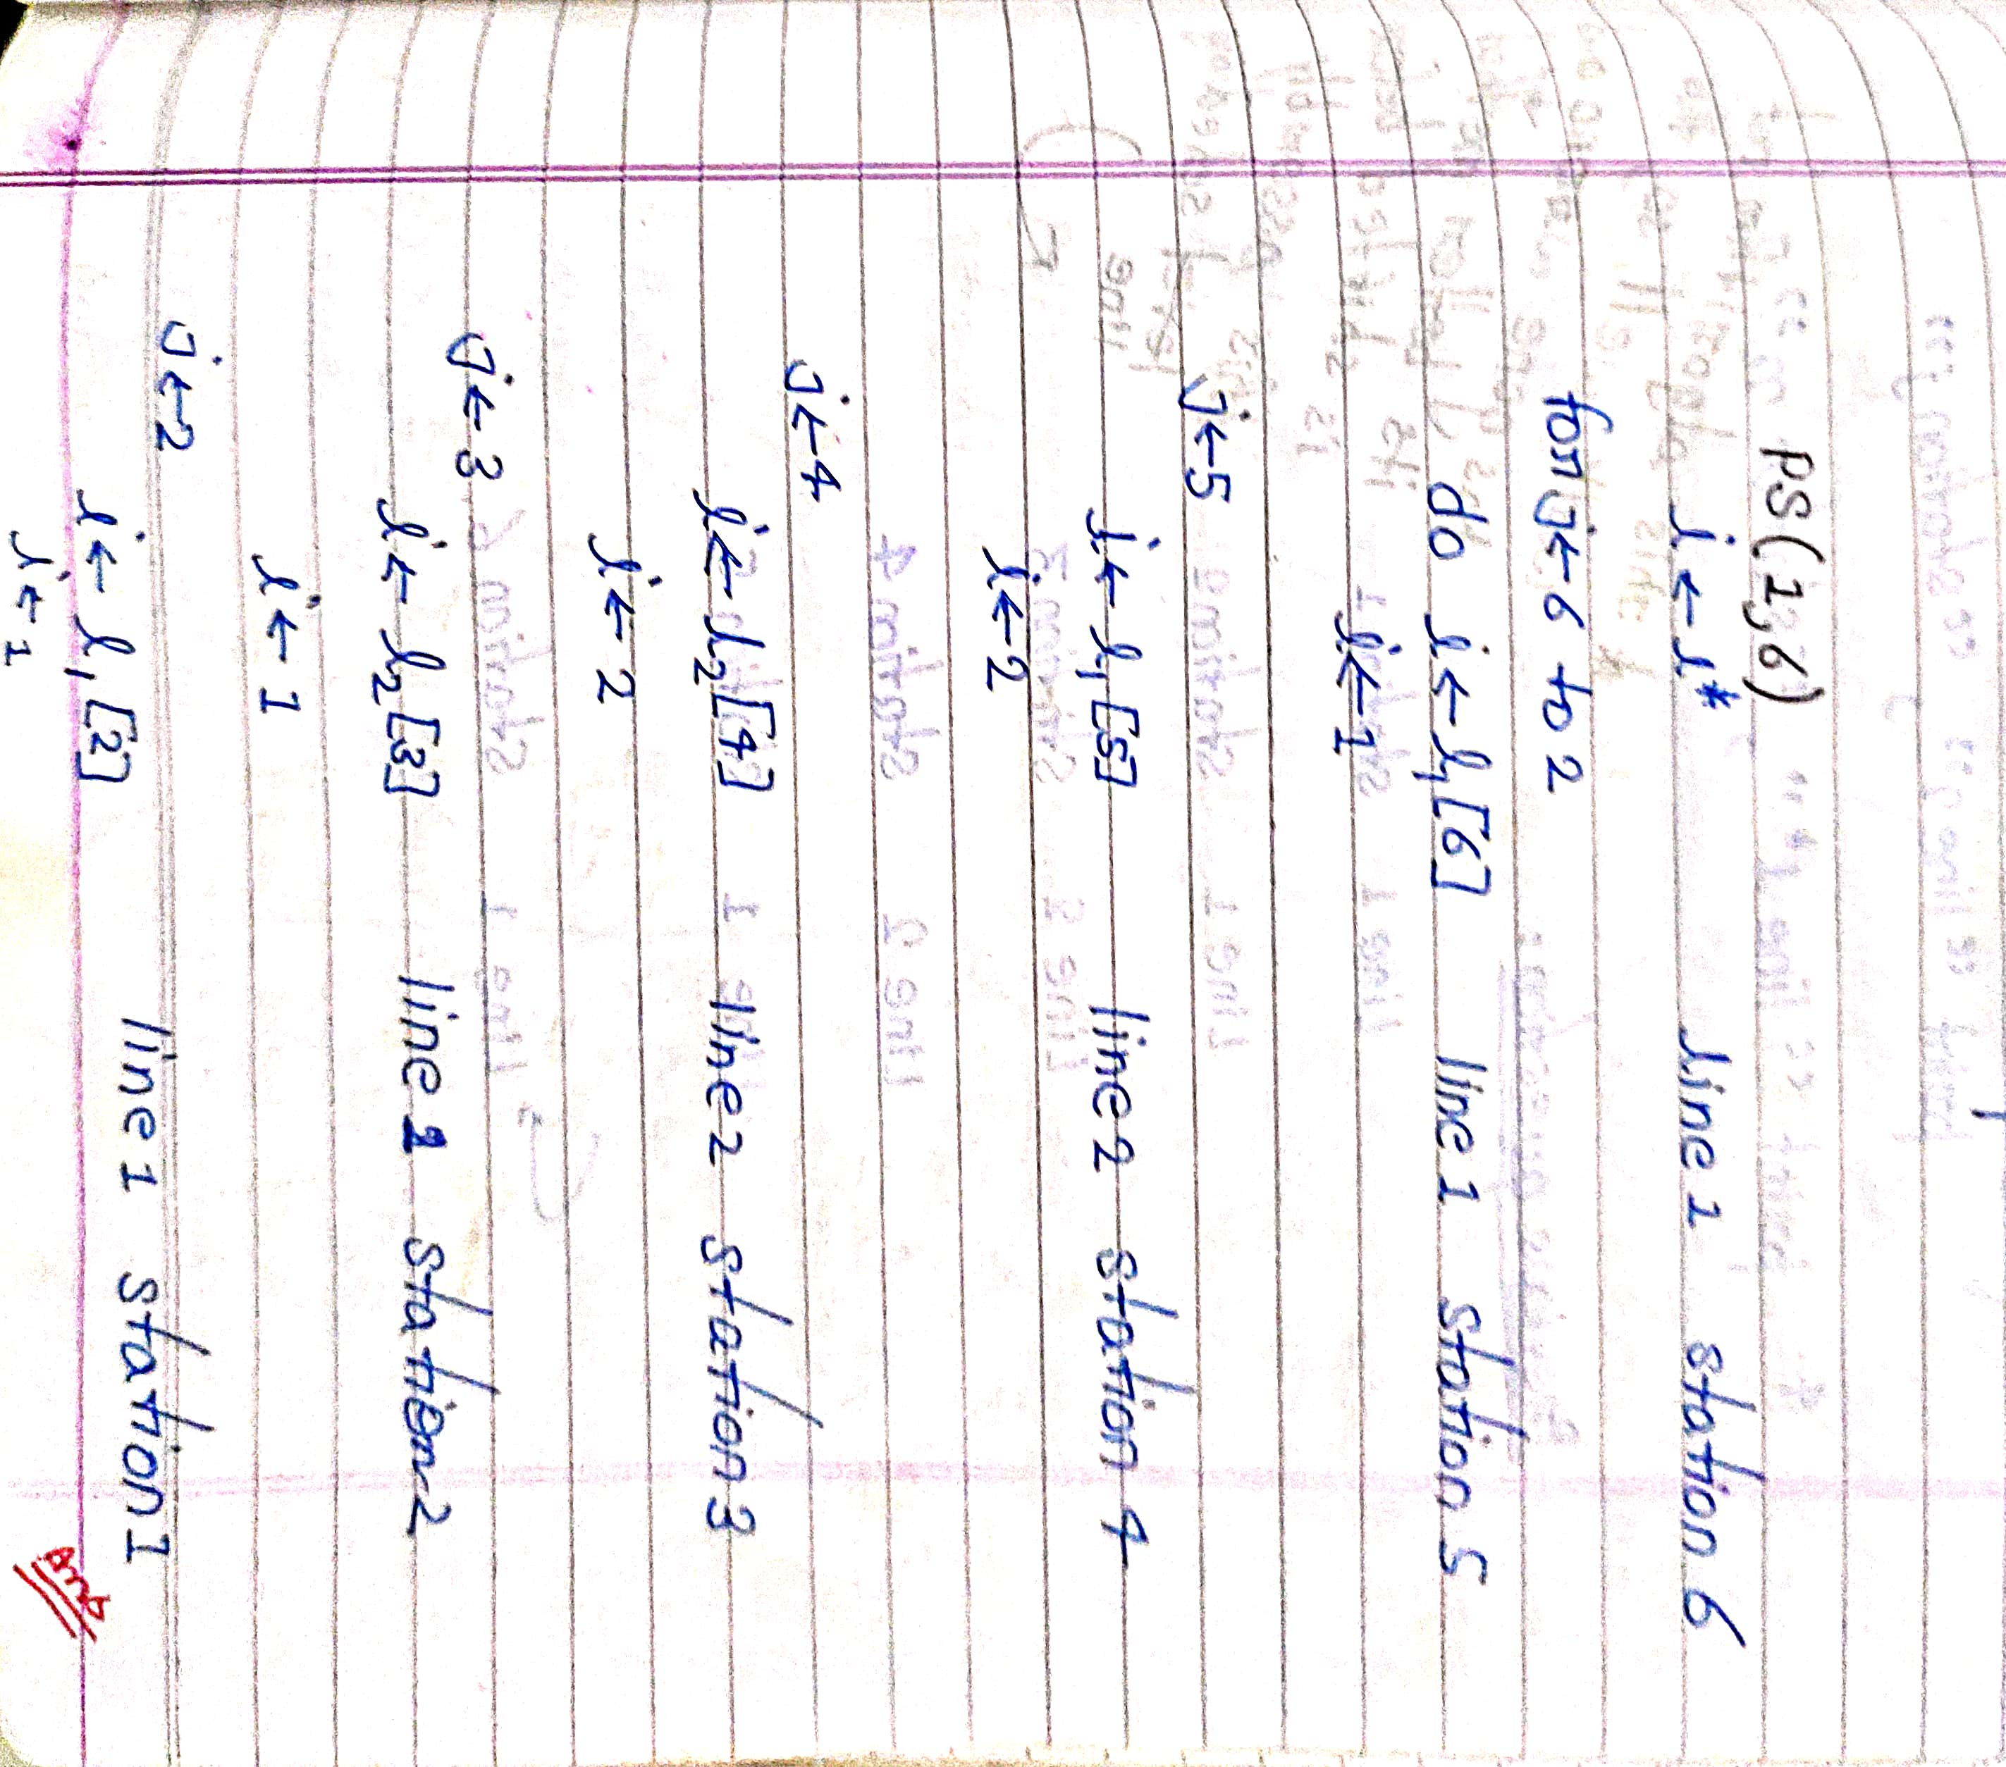

Slide 45
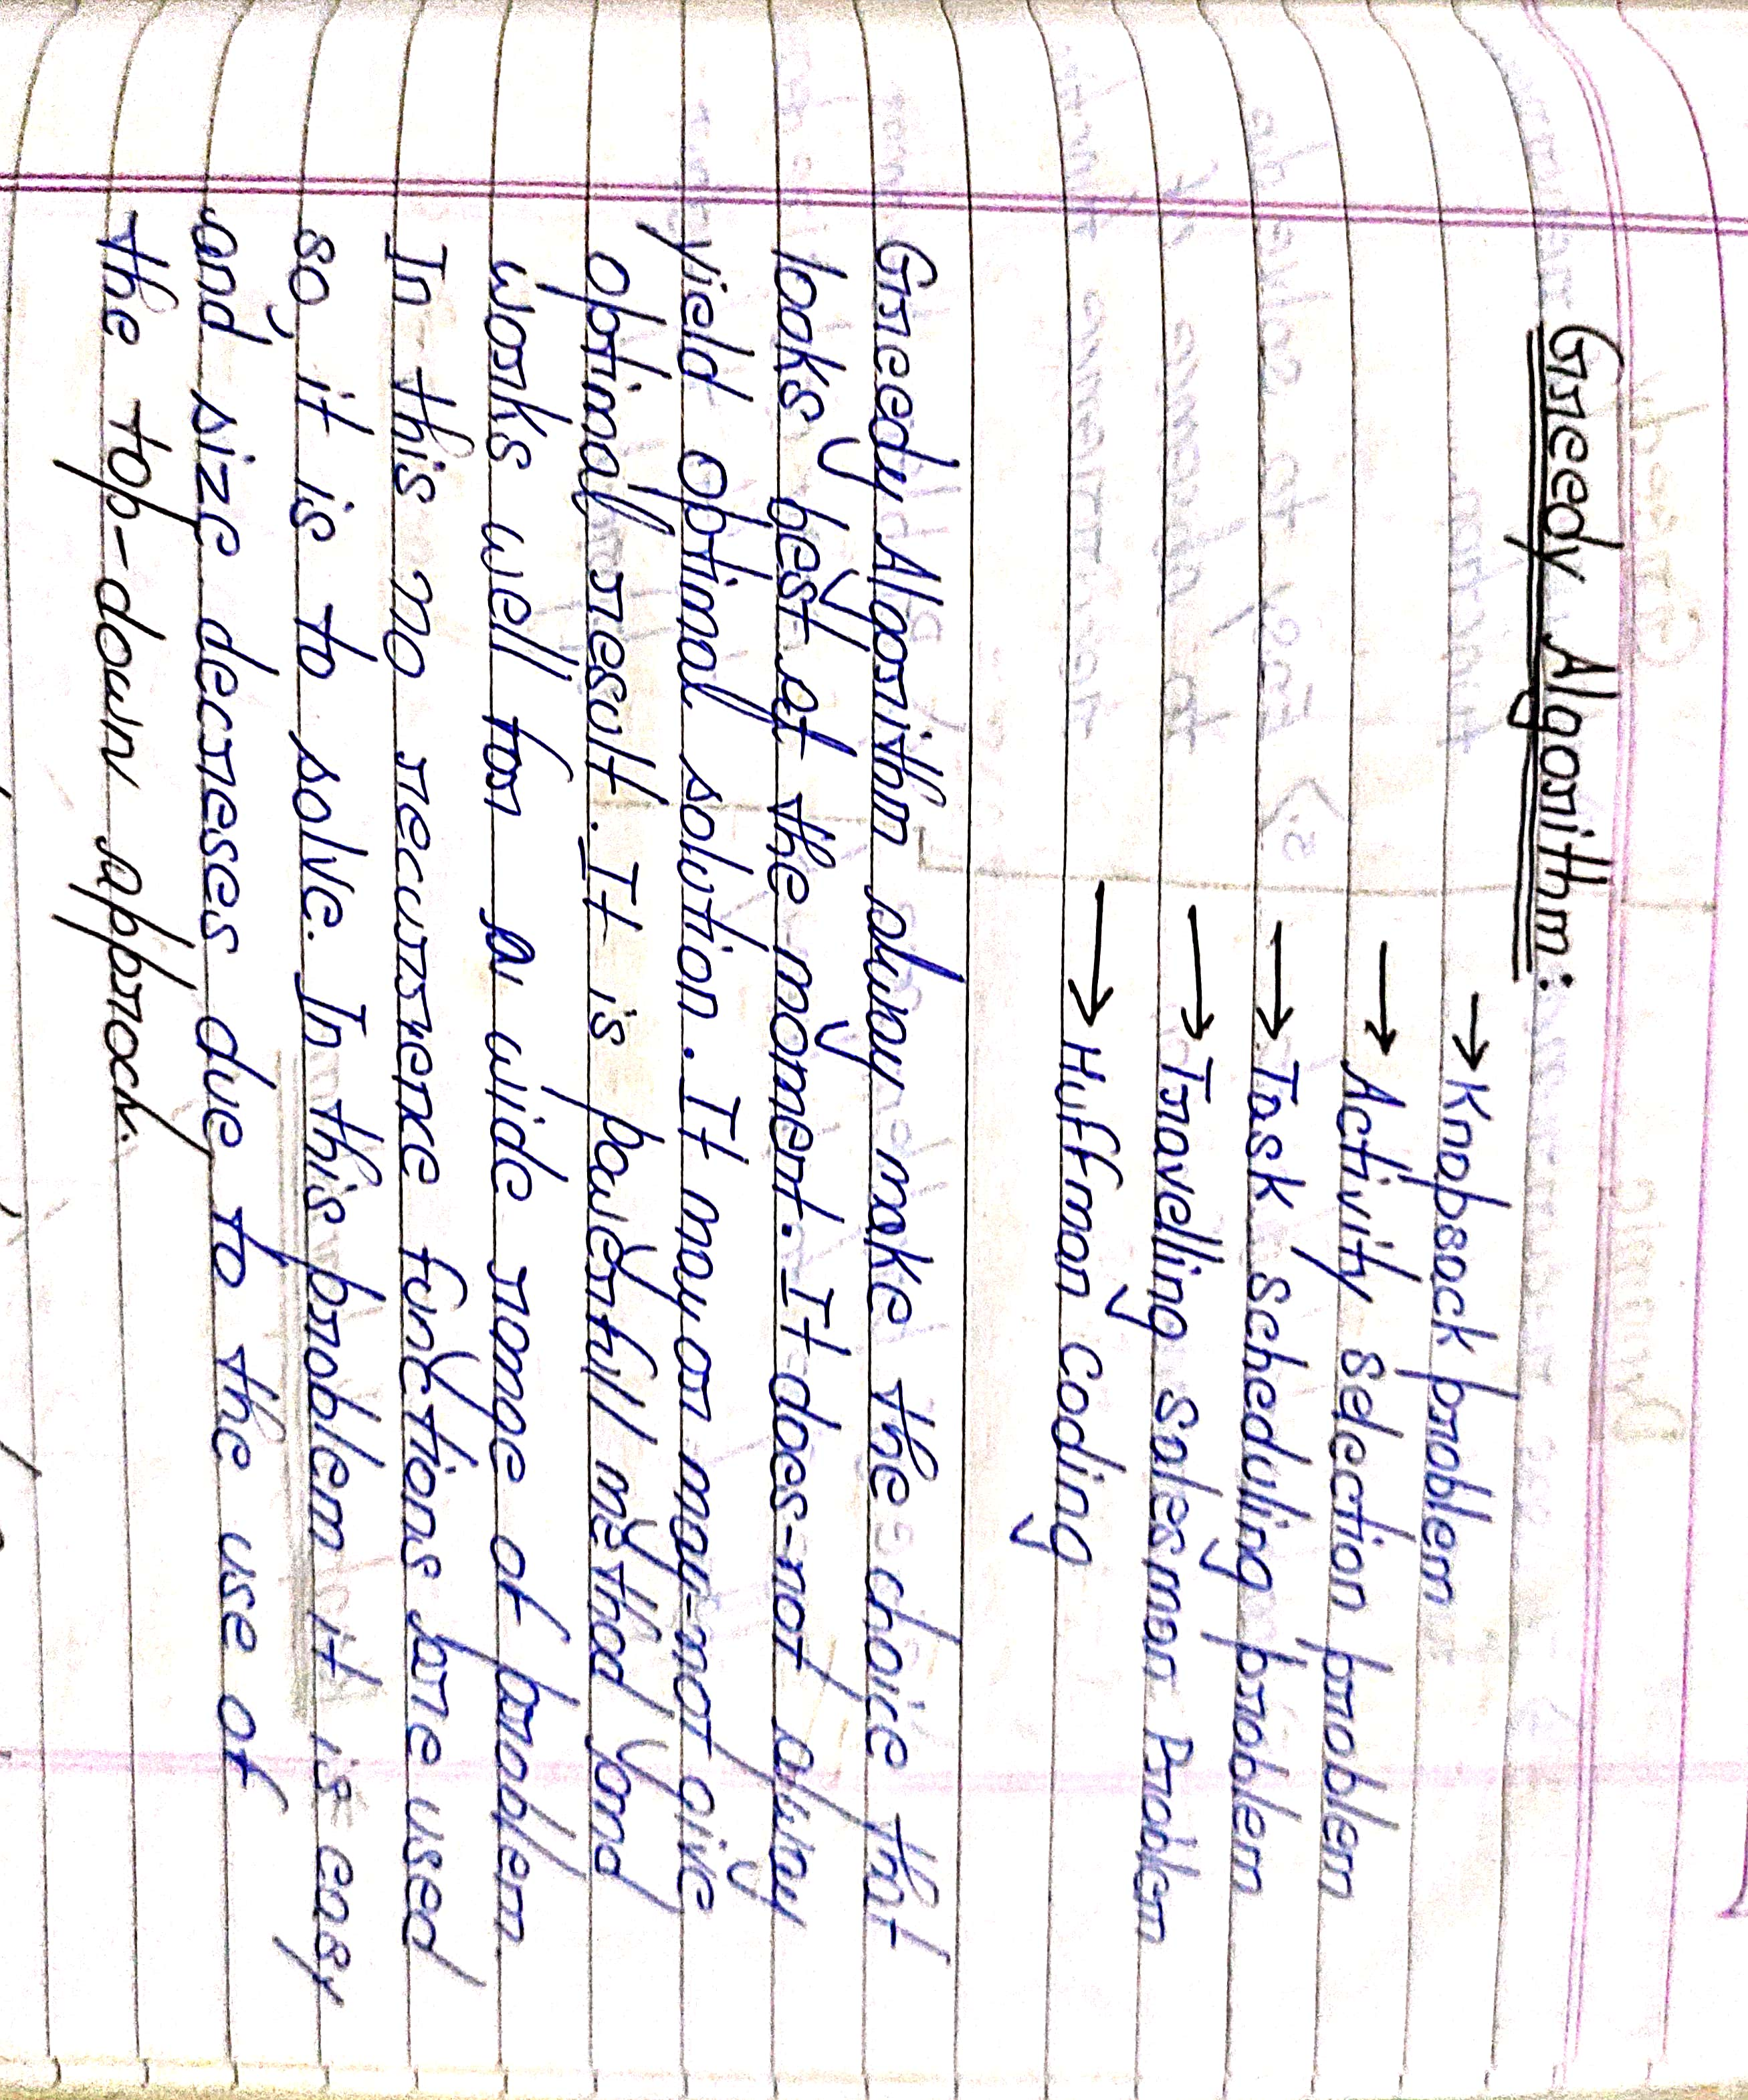
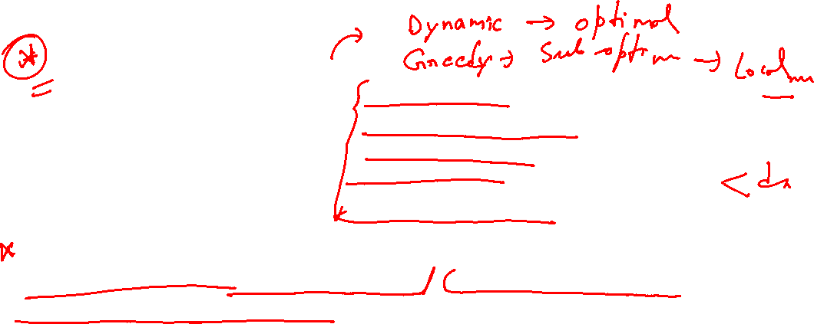

Slide 46
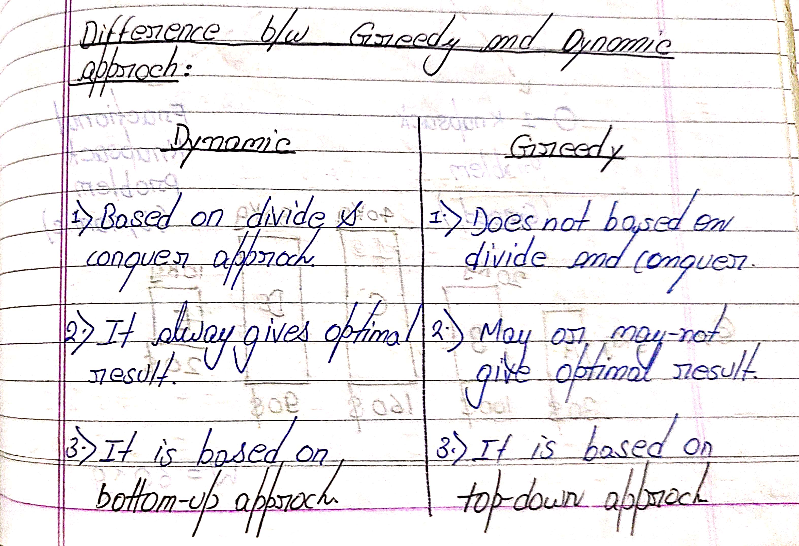


Slide 47



Slide 48

Dynamic
Greedy

Slide 49


Slide 50


Slide 51


Slide 52


